Slide 1

GASSMAN LAW ASSOCIATES, P.A. presents
The Physicians Guide to the
2013 Tax Laws
Monday, February 11, 2013
5:00 p.m.
Alan S. Gassman, J.D., LL.M.
agassman@gassmanpa.com

Slide 2

To view this webinar and download the accompanying materials please visit:
www.gassmanlawassociates.com/webinarlibrary.html

Slide 3
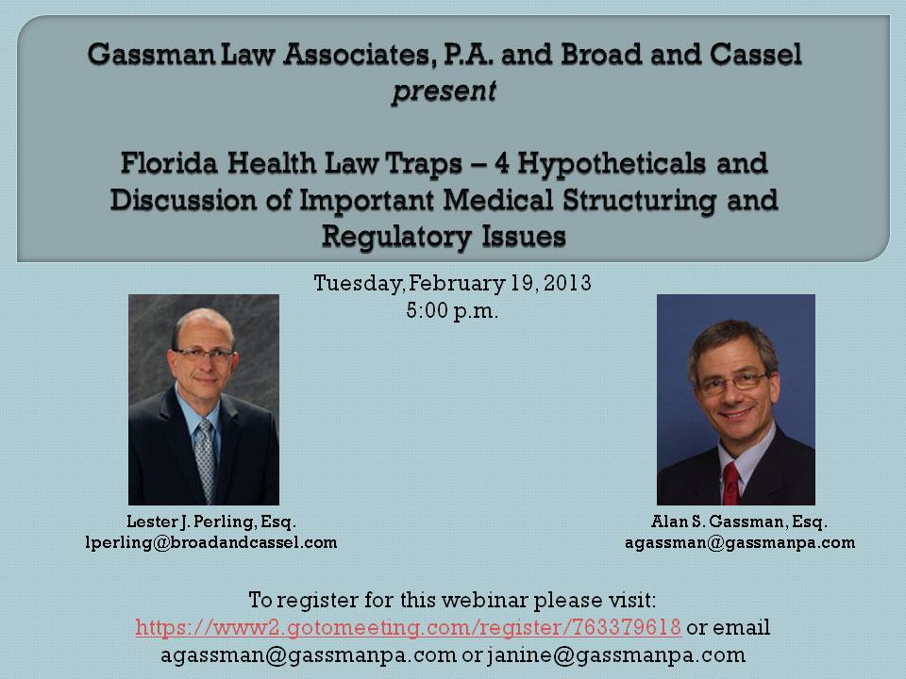

Slide 4

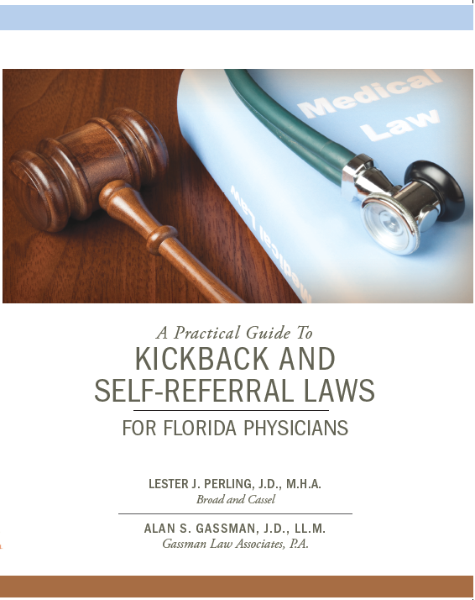
HADDON HALL PUBLISHING PRESENTS THE FOLLOWING BOOKS FOR PHYSICIANS:
To order either of the above books for a special rate of $1.99 for electronic and $9.99 printed, please email janine@gassmanpa.com
4
Copyright © 2013 Gassman Law Associates, P.A. EMAIL YOUR QUESTIONS TO: agassman@gassmanpa.com

Slide 5

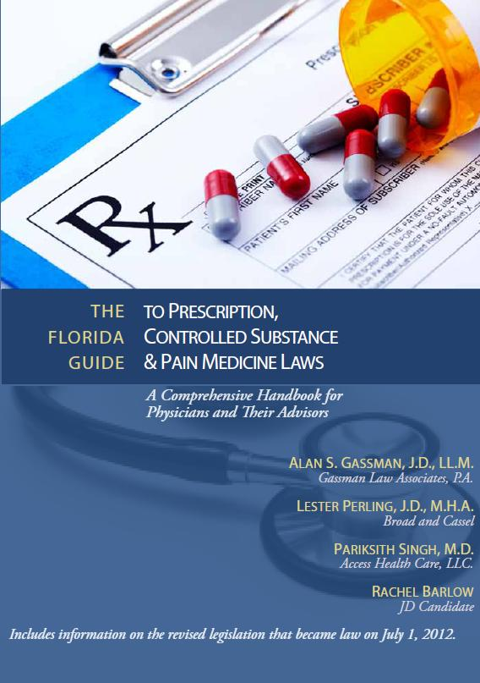
HADDON HALL PUBLISHING PRESENTS THE FOLLOWING BOOKS FOR PHYSICIANS:
To order either of the above books for a special rate of $1.99 for electronic and $9.99 printed, please email janine@gassmanpa.com
5
Copyright © 2013 Gassman Law Associates, P.A. EMAIL YOUR QUESTIONS TO: agassman@gassmanpa.com

Slide 6
Tax Law is Simple:
For purposes of paragraph (3) an organization described in paragraph (2) shall be deemed to include an organization described in Section 501(c)(4), (5), or (6) which would be described in paragraph (2) if it were an organization described in Section 501(c)(3).
- Internal Revenue Code Section 509
“Flush Language” -
Copyright © 2013 Gassman Law Associates, P.A. EMAIL YOUR QUESTIONS TO: agassman@gassmanpa.com
6

Slide 7
2013 TAX RATES SUMMARY FROM BOOK ENTITLED THE ESSENTIAL PLANNING GUIDE TO THE 2013 INCOME AND ESTATE TAX INCREASES
Copyright © 2013 Haddon Hall Publishing, LLP
 | 2012 | 2013 | 2013 Medicare Tax | 2013 Highest Tax
Long Term Capital Gain | 15% | 20% | 3.8% | 23.8%
Short Term Capital Gain | 35% | 39.6% | 3.8% | 43.4%
C Corporation Dividend Income | 15% | 20% | 3.8% | 23.8%
Ordinary Income | 35% | 39.6% | 3.8% | 43.4%
Employment Taxes | Employer: 1.45% Employee: 1.45% Total: 2.9% | Employer: 1.45% Employee: 2.35% Total: 3.8% (The additional .9% only applies as shown to the right.) | Additional .9% on wages exceeding $200,000 for single taxpayers and $250,000 or married taxpayers. | 3.8% total
FICA/FUTA Taxes | 6.2% Employer/4.2% Employee on wages up to $110,100. | 6.2% Employer 6.2% Employee on wages up to $113,700. | N/A | 12.4% on wages up to $113,700.
Estate Tax | $5,250,000 Exemption 35% Rate | $5,250,000 40% Rate | N/A | 40%
7
Copyright © 2013 Gassman Law Associates, P.A. EMAIL YOUR QUESTIONS TO: agassman@gassmanpa.com

Slide 8
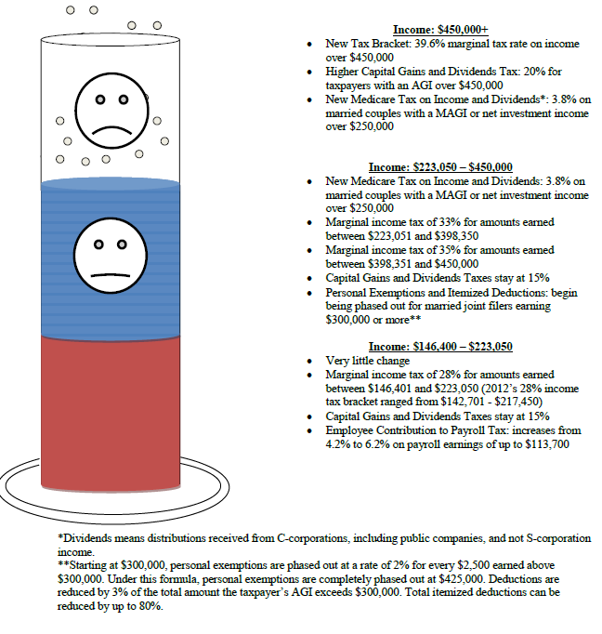
2013 Income Tax Changes by Tax Bracket for Married Joint Filers
8
Copyright © 2013 Gassman Law Associates, P.A. EMAIL YOUR QUESTIONS TO: agassman@gassmanpa.com

Slide 9
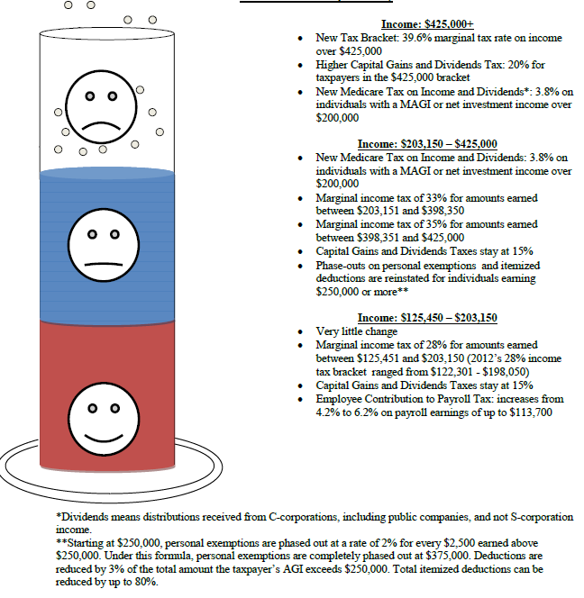
2013 Income Tax Changes by Tax Bracket for Head of Household (Single Filers with Dependent)
9
Copyright © 2013 Gassman Law Associates, P.A. EMAIL YOUR QUESTIONS TO: agassman@gassmanpa.com

Slide 10
2.38% Medicare Tax
2013 Tax Increases Individuals
Type of Income | Subject to the 3.8% Tax?
 | YES | NO
Interest and Dividends | X
Net Capital Gains | X
Royalties and Net Rental Income | X
Installment Sales Proceeds | X
Gain from the sale of personal residence in excess of the IRC § 121 exclusion | X
Passive Income from S Corporations | X
Passive Activity Income | X
Income from a trade or business that trades in financial instruments or commodities (hedge fund) | X
Active income from S corporations |  | X
Wages |  | X
Income from qualified pension, profit-sharing plan and stock bonus plans |  | X
Social Security Income |  | X
Tax exempt interest |  | X
10
Copyright © 2013 Gassman Law Associates, P.A. EMAIL YOUR QUESTIONS TO: agassman@gassmanpa.com

Slide 11
DEDUCTION REDUCTIONS
DEDUCTION/CREDIT | AGI PHASE OUT | AVAILABLE IN 2012? | AVAILABLE IN 2013?
Elimination of Itemized Deduction Limit | $250,000 for single filers $300,000 for joint filers | YES | NO Reduction of itemized deductions is required.
State and local sales tax deduction | $125,000 for single filers $250,000 for joint filers | NO | YES
Mortgage insurance premium deduction | $54,500 for single filers $109,000 for joint filers | YES; extended to December 31, 2013 | YES; extended to December 31, 2013
Tuition and fees deduction | $80,000 for single filers $160,000 for joint filers | NO | YES
Deduction for IRA contribution up to $100,000 to charity | N/A | NO | YES
Teacher’s supplies deduction | N/A | NO | YES
AMT Patch | See Chart Below for AMTI Phaseout of AMT Exemption | YES $50,600 for single filers $78,750 for married joint filers | YES $51,900 for single filers $80,800 for married joint filers
Mass Transportation benefit | N/A | NO | YES
Expanded student loan interest deduction | $75,000 for single filers $155,000 for joint filers | YES | YES. See chart below for phaseout.
Home energy credit | N/A | NO | NO
Expanded Adoption Credit | 2011 phase-out: $225,210 2012 phase-out: $229,710 | YES | YES
Child Tax Credit | $75,000 for single filers $110,000 for married filers | YES | YES – extended through 2018
American Opportunity Tax Credit | $90,000 for single filers $180,000 for joint filers | YES | YES – extended through 2018
Copyright © 2013 Gassman Law Associates, P.A. EMAIL YOUR QUESTIONS TO: agassman@gassmanpa.com
11

Slide 12
ITEMIZED DEDUCTIONS § 68
Prior to December 31, 2012, no reduction of itemized deductions was required – the reduction of itemized deduction for high-income taxpayers was repealed through December 31, 2012.
For tax years beginning after December 31, 2012, the American Taxpayer Relief Act of 2012, PL 112-240, amended IRC § 68, providing that an individual whose AGI exceeds the “applicable amount” must reduce the amount of allowable itemized deductions by the lesser of:
3% of excess over the applicable amount or
80% of allowable deductions.
The “applicable amount” in the amended § 68(b) is:
Example:
Single filer with no dependents and AGI = $300,000: AGI exceeds the phaseout threshold by $50,000 (= $300,000 - $250,000); 3% of $50,000 is $1,500. Itemized deductions may be reduced by $1,500, up to a maximum of 80% of itemized deductions.
Married couple with two children and AGI = $500,000: AGI exceeds the phaseout threshold by $200,000 (= $500,000 - $300,000); 3% of $200,000 = $6,000. Itemized deductions may be reduced by $6,000, up to a maximum of 80% of itemized deductions.
Joint Return or a Surviving Spouse | $300,000
Head of Household | $275,000
Single | $250,000
Married Filing Separately | $150,000
Copyright © 2013 Gassman Law Associates, P.A. EMAIL YOUR QUESTIONS TO: agassman@gassmanpa.com
12

Slide 13
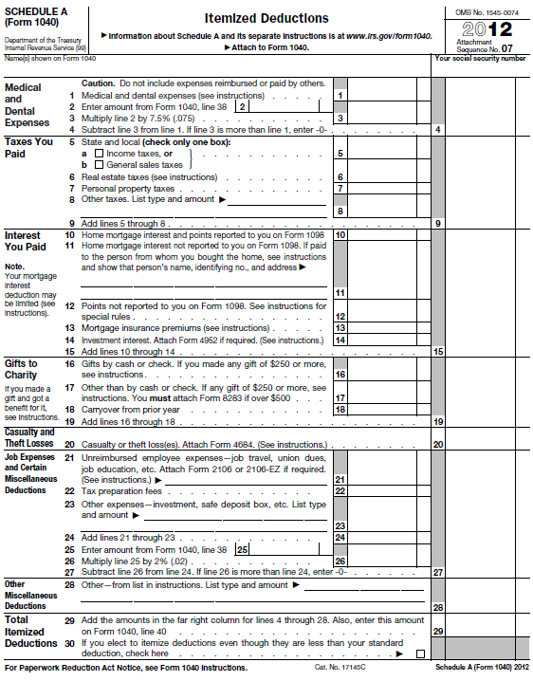
13

Slide 14
PERSONAL EXEMPTION § 151
See Rev.Proc. 2013-15; and Annual Inflation Adjustments for 2013, IR-2013-4.
An individual whose AGI exceeds the “applicable amount” must reduce the amount of allowable itemized deductions by the “applicable percentage” which is “2 percentage points for each $2,500 (or fraction thereof) by which the taxpayer’s AGI for the taxable year exceeds the threshold amount. In the case of a married individual filing a separate return, the preceding sentence shall be applied by substituting “$1,250” for $2,500”. In no event shall the applicable percentage exceed 100 percent.”
Year | Exemption Amount § 151 | Filer | AGI at which Exemption Begins to Phase Out | AGI at Which Exemption is Completely Phased Out
2012 | $3,800
2013 | $3,900 | Single | $250,000 | $373,500
 |  | Married | $300,000 | $422,500
Copyright © 2013 Gassman Law Associates, P.A. EMAIL YOUR QUESTIONS TO: agassman@gassmanpa.com
14

Slide 15
AMT EXEMPTION. See Rev. Proc. 2013-15
Year | Filer | Amount of Exemption | AMT Exemption is reduced by 25% of the amount that AMTI exceeds: | AMTI at which Deduction is Completely Phased Out | AMT Rate is 26%, up to the AMTI of: | AMT Rate is 28% on AMTI over:
2012 | Single | $50,600 | $112,500 | $314,900 | $175,000 | $175,000
 | Joint Married | $78750 | $150,000 | $465,000 | $175,000 | $175,000
 | MFS | $39,375 | $75,000 | $232,500 | $87,500 | $87,500
2013 | Single | $51,900 | $115,400 | (Info not provided in Rev. Proc. 2013-15) |  | $179,500
 | Joint Married | $80,800 | $153,900 |  |  | $179,500
 | MFS | $40,400 | $76,950 |  |  | $89,750
Copyright © 2013 Gassman Law Associates, P.A. EMAIL YOUR QUESTIONS TO: agassman@gassmanpa.com
15

Slide 16
STUDENT LOAN INTEREST DEDUCTIBILITY. See Pub 970 (2011); Pub 17 (2012)
Year | Filer | AGI at which Deduction Begins to Phase Out | AGI at Which Deduction is Completely Phased Out
2011 | Single | $60,000 | $75,000
 | Joint | $120,000 | $150,000
2012 | Single | $60,000 | $75,000
 | Joint | $125,000 | $155,000
2013
The increased MAGI phase out ranges for the student loan interest deduction have been made permanent (IRC § 221(b)(2)), by striking title IX of the Economic Growth and Tax Reconciliation Act of 2001 (PL 107-16). In addition, the 60 month (5-year) deduction limitation and non-deductibility of voluntary payments is permanently stricken.
Copyright © 2013 Gassman Law Associates, P.A. EMAIL YOUR QUESTIONS TO: agassman@gassmanpa.com
16

Slide 17
 |  |  |  |  |  |  |  |  |  |  |  |  |  |  |  |  |  |  |  |  |  |  |  | TOTAL
 |  |  |  |  | Jan 12 |  | Budget |  | Feb 12 |  | Budget |  | Mar 12 |  | Budget |  | Apr 12 |  | Budget |  | May 12 |  | Budget | Jan - Dec 12 |  | Budget
 |  | Expense
 |  |  | 300 West First Street
 |  |  |  | Real Estate Taxes | 0.00 |  |  |  | 0.00 |  |  |  | 0.00 |  |  |  | 0.00 |  |  |  | 0.00 |  |  | 0.00
 |  |  |  | Sales Tax | 0.00 |  |  |  | 0.00 |  |  |  | 0.00 |  |  |  | 0.00 |  |  |  | 0.00 |  |  | 0.00
 |  |  | Total 300 West First Street Expenses |  | 0.00 |  |  |  | 0.00 |  |  |  | 0.00 |  |  |  | 0.00 |  |  |  | 0.00 |  |  | 0.00
 |  |  | Accounting |  | 0.00 |  |  |  | 0.00 |  |  |  | 0.00 |  |  |  | 0.00 |  |  |  | 0.00 |  |  | 0.00
 |  |  | Auto
 |  |  |  | Gas | 0.00 |  |  |  | 0.00 |  |  |  | 0.00 |  |  |  | 0.00 |  |  |  | 0.00 |  |  | 0.00
 |  |  |  | Maintenance Agreements | 0.00 |  |  |  | 0.00 |  |  |  | 0.00 |  |  |  | 0.00 |  |  |  | 0.00 |  |  | 0.00
 |  |  |  | Registration | 0.00 |  |  |  | 0.00 |  |  |  | 0.00 |  |  |  | 0.00 |  |  |  | 0.00 |  |  | 0.00
 |  |  |  | Service | 0.00 |  |  |  | 0.00 |  |  |  | 0.00 |  |  |  | 0.00 |  |  |  | 0.00 |  |  | 0.00
 |  |  |  | Auto - Other | 0.00 |  |  |  | 0.00 |  |  |  | 0.00 |  |  |  | 0.00 |  |  |  | 0.00 |  |  | 0.00
 |  |  | Total Auto |  | 0.00 |  |  |  | 0.00 |  |  |  | 0.00 |  |  |  | 0.00 |  |  |  | 0.00 |  |  | 0.00
 |  |  | Bank Charge |  | 0.00 |  |  |  | 0.00 |  |  |  | 0.00 |  |  |  | 0.00 |  |  |  | 0.00 |  |  | 0.00
 |  |  | Child 1 Expenses
 |  |  |  | Allowance | 0.00 |  |  |  | 0.00 |  |  |  | 0.00 |  |  |  | 0.00 |  |  |  | 0.00 |  |  | 0.00
 |  |  |  | Auto | 0.00 |  |  |  | 0.00 |  |  |  | 0.00 |  |  |  | 0.00 |  |  |  | 0.00 |  |  | 0.00
 |  |  |  | Auto Insurance | 0.00 |  |  |  | 0.00 |  |  |  | 0.00 |  |  |  | 0.00 |  |  |  | 0.00 |  |  | 0.00
 |  |  |  | CC in excess of allowance | 0.00 |  |  |  | 0.00 |  |  |  | 0.00 |  |  |  | 0.00 |  |  |  | 0.00 |  |  | 0.00
 |  |  |  | Dry Cleaning and Laundry | 0.00 |  |  |  | 0.00 |  |  |  | 0.00 |  |  |  | 0.00 |  |  |  | 0.00 |  |  | 0.00
 |  |  |  | Education-Books and Supplies | 0.00 |  |  |  | 0.00 |  |  |  | 0.00 |  |  |  | 0.00 |  |  |  | 0.00 |  |  | 0.00
 |  |  |  | Education-Tuiton | 0.00 |  |  |  | 0.00 |  |  |  | 0.00 |  |  |  | 0.00 |  |  |  | 0.00 |  |  | 0.00
 |  |  |  | Education Associations | 0.00 |  |  |  | 0.00 |  |  |  | 0.00 |  |  |  | 0.00 |  |  |  | 0.00 |  |  | 0.00
 |  |  |  | Groceries | 0.00 |  |  |  | 0.00 |  |  |  | 0.00 |  |  |  | 0.00 |  |  |  | 0.00 |  |  | 0.00
 |  |  |  | Insurance Health | 0.00 |  |  |  | 0.00 |  |  |  | 0.00 |  |  |  | 0.00 |  |  |  | 0.00 |  |  | 0.00
 |  |  |  | Pharmacy | 0.00 |  |  |  | 0.00 |  |  |  | 0.00 |  |  |  | 0.00 |  |  |  | 0.00 |  |  | 0.00
 |  |  |  | Shipping | 0.00 |  |  |  | 0.00 |  |  |  | 0.00 |  |  |  | 0.00 |  |  |  | 0.00 |  |  | 0.00
 |  |  |  | Expenses - Other | 0.00 |  |  |  | 0.00 |  |  |  | 0.00 |  |  |  | 0.00 |  |  |  | 0.00 |  |  | 0.00
 |  |  | Total Expenses |  | 0.00 |  |  |  | 0.00 |  |  |  | 0.00 |  |  |  | 0.00 |  |  |  | 0.00 |  |  | 0.00
 |  |  | Cash Withdrawals
 |  |  |  | Cash Withdrawal- | 0.00 |  |  |  | 0.00 |  |  |  | 0.00 |  |  |  | 0.00 |  |  |  | 0.00
 |  |  |  | Cash Withdrawal | 0.00 |  |  |  | 0.00 |  |  |  | 0.00 |  |  |  | 0.00 |  |  |  | 0.00 |  |  | #REF!
 |  |  | Total Cash Withdrawals |  | 0.00 |  |  |  | 0.00 |  |  |  | 0.00 |  |  |  | 0.00 |  |  |  | 0.00 |  |  | 0.00
 |  |  |  |  |  |  |  |  |  |  |  |  |  |  |  |  |  |  |  |  |  |  |  | TOTAL
Copyright © 2013 Gassman Law Associates, P.A. EMAIL YOUR QUESTIONS TO: agassman@gassmanpa.com
17

Slide 18
 |  |  |  |  | Jan 12 |  | Budget |  | Feb 12 |  | Budget |  | Mar 12 |  | Budget |  | Apr 12 |  | Budget |  | May 12 |  | Budget | Jan - Dec 12 |  | Budget
 |  |  | Clothing, Shoes & Skincare
 |  |  |  | Husband | 0.00 |  |  |  | 0.00 |  |  |  | 0.00 |  |  |  | 0.00 |  |  |  | 0.00 |  |  | 0.00
 |  |  |  | Wife | 0.00 |  |  |  | 0.00 |  |  |  | 0.00 |  |  |  | 0.00 |  |  |  | 0.00 |  |  | 0.00
 |  |  |  | Child 1 | 0.00 |  |  |  | 0.00 |  |  |  | 0.00 |  |  |  | 0.00 |  |  |  | 0.00 |  |  | 0.00
 |  |  |  | Child 2 | 0.00 |  |  |  | 0.00 |  |  |  | 0.00 |  |  |  | 0.00 |  |  |  | 0.00 |  |  | 0.00
 |  |  | Total Clothing, Shoes & Skincare |  | 0.00 |  |  |  | 0.00 |  |  |  | 0.00 |  |  |  | 0.00 |  |  |  | 0.00 |  |  | 0.00
 |  |  | Dining
 |  |  |  | Business Related | 0.00 |  |  |  | 0.00 |  |  |  | 0.00 |  |  |  | 0.00 |  |  |  | 0.00 |  |  | 0.00
 |  |  |  | Family | 0.00 |  |  |  | 0.00 |  |  |  | 0.00 |  |  |  | 0.00 |  |  |  | 0.00 |  |  | 0.00
 |  |  |  | Therapy | 0.00 |  |  |  | 0.00 |  |  |  | 0.00 |  |  |  | 0.00 |  |  |  | 0.00 |  |  | #REF!
 |  |  |  | Dining - Other | 0.00 |  |  |  | 0.00 |  |  |  | 0.00 |  |  |  | 0.00 |  |  |  | 0.00 |  |  | 0.00
 |  |  | Total Dining |  | 0.00 |  |  |  | 0.00 |  |  |  | 0.00 |  |  |  | 0.00 |  |  |  | 0.00 |  |  | 0.00
 |  |  | Donations |  | 0.00 |  |  |  | 0.00 |  |  |  | 0.00 |  |  |  | 0.00 |  |  |  | 0.00 |  |  | #REF!
 |  |  | Dry Cleaning |  | 0.00 |  |  |  | 0.00 |  |  |  | 0.00 |  |  |  | 0.00 |  |  |  | 0.00 |  |  | #REF!
 |  |  | Dues and Subscriptions |  | 0.00 |  |  |  | 0.00 |  |  |  | 0.00 |  |  |  | 0.00 |  |  |  | 0.00 |  |  | 0.00
 |  |  | Entertainment |  | 0.00 |  |  |  | 0.00 |  |  |  | 0.00 |  |  |  | 0.00 |  |  |  | 0.00 |  |  | 0.00
 |  |  | Gifts |  | 0.00 |  |  |  | 0.00 |  |  |  | 0.00 |  |  |  | 0.00 |  |  |  | 0.00 |  |  | 0.00
 |  |  | Groceries |  | 0.00 |  |  |  | 0.00 |  |  |  | 0.00 |  |  |  | 0.00 |  |  |  | 0.00 |  |  | 0.00
 |  |  | Hair & Nails |  | 0.00 |  |  |  | 0.00 |  |  |  | 0.00 |  |  |  | 0.00 |  |  |  | 0.00 |  |  | 0.00
 |  |  | Health & Fitness |  | 0.00 |  |  |  | 0.00 |  |  |  | 0.00 |  |  |  | 0.00 |  |  |  | 0.00 |  |  | 0.00
 |  |  | Hobbies |  | 0.00 |  |  |  | 0.00 |  |  |  | 0.00 |  |  |  | 0.00 |  |  |  | 0.00 |  |  | 0.00
 |  |  | Homeowner's Association Fees |  | 0.00 |  |  |  | 0.00 |  |  |  | 0.00 |  |  |  | 0.00 |  |  |  | 0.00 |  |  | 0.00
 |  |  | Household
 |  |  |  | Alarm | 0.00 |  |  |  | 0.00 |  |  |  | 0.00 |  |  |  | 0.00 |  |  |  | 0.00 |  |  | 0.00
 |  |  |  | Cable & Satellite TV | 0.00 |  |  |  | 0.00 |  |  |  | 0.00 |  |  |  | 0.00 |  |  |  | 0.00 |  |  | 0.00
 |  |  |  | Cleaning | 0.00 |  |  |  | 0.00 |  |  |  | 0.00 |  |  |  | 0.00 |  |  |  | 0.00 |  |  | 0.00
 |  |  |  | Crystal Springs Water | 0.00 |  |  |  | 0.00 |  |  |  | 0.00 |  |  |  | 0.00 |  |  |  | 0.00 |  |  | 0.00
 |  |  |  | Garbage, Recycling & Water | 0.00 |  |  |  | 0.00 |  |  |  | 0.00 |  |  |  | 0.00 |  |  |  | 0.00 |  |  | 0.00
 |  |  |  | Gas & Electric | 0.00 |  |  |  | 0.00 |  |  |  | 0.00 |  |  |  | 0.00 |  |  |  | 0.00 |  |  | 0.00
 |  |  |  | Lawn | 0.00 |  |  |  | 0.00 |  |  |  | 0.00 |  |  |  | 0.00 |  |  |  | 0.00 |  |  | 0.00
 |  |  |  | Lawn Pest Control | 0.00 |  |  |  | 0.00 |  |  |  | 0.00 |  |  |  | 0.00 |  |  |  | 0.00 |  |  | #REF!
 |  |  |  | Pest Control | 0.00 |  |  |  | 0.00 |  |  |  | 0.00 |  |  |  | 0.00 |  |  |  | 0.00 |  |  | #REF!
 |  |  |  | Pool | 0.00 |  |  |  | 0.00 |  |  |  | 0.00 |  |  |  | 0.00 |  |  |  | 0.00 |  |  | 0.00
 |  |  |  | Repairs, Maintenance & Improv | 0.00 |  |  |  | 0.00 |  |  |  | 0.00 |  |  |  | 0.00 |  |  |  | 0.00 |  |  | 0.00
 |  |  |  | Salt Delivery | 0.00 |  |  |  | 0.00 |  |  |  | 0.00 |  |  |  | 0.00 |  |  |  | 0.00 |  |  | 0.00
 |  |  |  | Supplies and Tools | 0.00 |  |  |  | 0.00 |  |  |  | 0.00 |  |  |  | 0.00 |  |  |  | 0.00 |  |  | 0.00
 |  |  |  | Utilities | 0.00 |  |  |  | 0.00 |  |  |  | 0.00 |  |  |  | 0.00 |  |  |  | 0.00 |  |  | 0.00
 |  |  |  | Wine Collection | 0.00 |  |  |  | 0.00 |  |  |  | 0.00 |  |  |  | 0.00 |  |  |  | 0.00 |  |  | 0.00
 |  |  |  | Other | 0.00 |  |  |  | 0.00 |  |  |  | 0.00 |  |  |  | 0.00 |  |  |  | 0.00 |  |  | #REF!
Copyright © 2013 Gassman Law Associates, P.A. EMAIL YOUR QUESTIONS TO: agassman@gassmanpa.com
18

Slide 19
 |  |  |  |  |  |  |  |  |  |  |  |  |  |  |  |  |  |  |  |  |  |  |  | TOTAL
 |  |  |  |  | Jan 12 |  | Budget |  | Feb 12 |  | Budget |  | Mar 12 |  | Budget |  | Apr 12 |  | Budget |  | May 12 |  | Budget | Jan - Dec 12 |  | Budget
 |  |  | Vacation Home
 |  |  |  | Cleaning | 0.00 |  |  |  | 0.00 |  |  |  | 0.00 |  |  |  | 0.00 |  |  |  | 0.00 |  |  | #REF!
 |  |  |  | Electric | 0.00 |  |  |  | 0.00 |  |  |  | 0.00 |  |  |  | 0.00 |  |  |  | 0.00 |  |  | 0.00
 |  |  |  | Garbage | 0.00 |  |  |  | 0.00 |  |  |  | 0.00 |  |  |  | 0.00 |  |  |  | 0.00 |  |  | 0.00
 |  |  |  | Lawn & Tree Service | 0.00 |  |  |  | 0.00 |  |  |  | 0.00 |  |  |  | 0.00 |  |  |  | 0.00 |  |  | 0.00
 |  |  |  | Repairs and Improvements | 0.00 |  |  |  | 0.00 |  |  |  | 0.00 |  |  |  | 0.00 |  |  |  | 0.00 |  |  | 0.00
 |  |  |  | Satellite Dish | 0.00 |  |  |  | 0.00 |  |  |  | 0.00 |  |  |  | 0.00 |  |  |  | 0.00 |  |  | 0.00
 |  |  |  | Supplies and Tools | 0.00 |  |  |  | 0.00 |  |  |  | 0.00 |  |  |  | 0.00 |  |  |  | 0.00 |  |  | #REF!
 |  |  | Total Household |  | 0.00 |  |  |  | 0.00 |  |  |  | 0.00 |  |  |  | 0.00 |  |  |  | 0.00 |  |  | 0.00
 |  |  | Insurance
 |  |  |  | Auto | 0.00 |  |  |  | 0.00 |  |  |  | 0.00 |  |  |  | 0.00 |  |  |  | 0.00 |  |  | #REF!
 |  |  |  | Disability | 0.00 |  |  |  | 0.00 |  |  |  | 0.00 |  |  |  | 0.00 |  |  |  | 0.00 |  |  | #REF!
 |  |  |  | Flood | 0.00 |  |  |  | 0.00 |  |  |  | 0.00 |  |  |  | 0.00 |  |  |  | 0.00 |  |  | #REF!
 |  |  |  | Homeowners | 0.00 |  |  |  | 0.00 |  |  |  | 0.00 |  |  |  | 0.00 |  |  |  | 0.00 |  |  | #REF!
 |  |  |  | Life | 0.00 |  |  |  | 0.00 |  |  |  | 0.00 |  |  |  | 0.00 |  |  |  | 0.00 |  |  | #REF!
 |  |  | Total Insurance |  | 0.00 |  |  |  | 0.00 |  |  |  | 0.00 |  |  |  | 0.00 |  |  |  | 0.00 |  |  | #REF!
 |  |  | IRA Contrib |  | 0.00 |  |  |  | 0.00 |  |  |  | 0.00 |  |  |  | 0.00 |  |  |  | 0.00 |  |  | #REF!
 |  |  | IRA Contrib Spouse |  | 0.00 |  |  |  | 0.00 |  |  |  | 0.00 |  |  |  | 0.00 |  |  |  | 0.00 |  |  | #REF!
 |  |  | Library |  | 0.00 |  |  |  | 0.00 |  |  |  | 0.00 |  |  |  | 0.00 |  |  |  | 0.00 |  |  | 0.00
 |  |  | Medical
 |  |  |  | Contacts | 0.00 |  |  |  | 0.00 |  |  |  | 0.00 |  |  |  | 0.00 |  |  |  | 0.00 |  |  | 0.00
 |  |  |  | Dental | 0.00 |  |  |  | 0.00 |  |  |  | 0.00 |  |  |  | 0.00 |  |  |  | 0.00 |  |  | 0.00
 |  |  |  | Pharmacy | 0.00 |  |  |  | 0.00 |  |  |  | 0.00 |  |  |  | 0.00 |  |  |  | 0.00 |  |  | 0.00
 |  |  |  | Physicians | 0.00 |  |  |  | 0.00 |  |  |  | 0.00 |  |  |  | 0.00 |  |  |  | 0.00 |  |  | 0.00
 |  |  | Total Medical |  | 0.00 |  |  |  | 0.00 |  |  |  | 0.00 |  |  |  | 0.00 |  |  |  | 0.00 |  |  | 0.00
 |  |  | Condo
 |  |  |  | Condo Dues | 0.00 |  |  |  | 0.00 |  |  |  | 0.00 |  |  |  | 0.00 |  |  |  | 0.00 |  |  | 0.00
 |  |  |  | Home Improvement | 0.00 |  |  |  | 0.00 |  |  |  | 0.00 |  |  |  | 0.00 |  |  |  | 0.00 |  |  | #REF!
 |  |  |  | Insurance | 0.00 |  |  |  | 0.00 |  |  |  | 0.00 |  |  |  | 0.00 |  |  |  | 0.00 |  |  | 0.00
 |  |  |  | Repairs and Maintenance | 0.00 |  |  |  | 0.00 |  |  |  | 0.00 |  |  |  | 0.00 |  |  |  | 0.00 |  |  | #REF!
 |  |  | Total Condo |  | 0.00 |  |  |  | 0.00 |  |  |  | 0.00 |  |  |  | 0.00 |  |  |  | 0.00 |  |  | 0.00
 |  |  | Misc. |  | 0.00 |  |  |  | 0.00 |  |  |  | 0.00 |  |  |  | 0.00 |  |  |  | 0.00 |  |  | #REF!
 |  |  | Child 2 Expenses
 |  |  |  | Auto Expense | 0.00 |  |  |  | 0.00 |  |  |  | 0.00 |  |  |  | 0.00 |  |  |  | 0.00 |  |  | #REF!
 |  |  |  | Books & Supplies | 0.00 |  |  |  | 0.00 |  |  |  | 0.00 |  |  |  | 0.00 |  |  |  | 0.00 |  |  | #REF!
 |  |  |  | CC in excess of Allowance | 0.00 |  |  |  | 0.00 |  |  |  | 0.00 |  |  |  | 0.00 |  |  |  | 0.00 |  |  | #REF!
 |  |  |  | Education-Tuition | 0.00 |  |  |  | 0.00 |  |  |  | 0.00 |  |  |  | 0.00 |  |  |  | 0.00 |  |  | #REF!
 |  |  |  | Health & Fitness | 0.00 |  |  |  | 0.00 |  |  |  | 0.00 |  |  |  | 0.00 |  |  |  | 0.00 |  |  | #REF!
 |  |  |  | Internship Travel | 0.00 |  |  |  | 0.00 |  |  |  | 0.00 |  |  |  | 0.00 |  |  |  | 0.00 |  |  | #REF!
 |  |  |  | Meetings and Travel Education | 0.00 |  |  |  | 0.00 |  |  |  | 0.00 |  |  |  | 0.00 |  |  |  | 0.00 |  |  | #REF!
 |  |  |  | Pet Expense | 0.00 |  |  |  | 0.00 |  |  |  | 0.00 |  |  |  | 0.00 |  |  |  | 0.00 |  |  | #REF!
 |  |  |  | Expenses - Other | 0.00 |  |  |  | 0.00 |  |  |  | 0.00 |  |  |  | 0.00 |  |  |  | 0.00 |  |  | 0.00
 |  |  | Total Expenses |  | 0.00 |  |  |  | 0.00 |  |  |  | 0.00 |  |  |  | 0.00 |  |  |  | 0.00 |  |  | 0.00
19
Copyright © 2013 Gassman Law Associates, P.A. EMAIL YOUR QUESTIONS TO: agassman@gassmanpa.com

Slide 20
 |  |  |  |  |  |  |  |  |  |  |  |  |  |  |  |  |  |  |  |  |  |  |  | TOTAL
 |  |  |  |  | Jan 12 |  | Budget |  | Feb 12 |  | Budget |  | Mar 12 |  | Budget |  | Apr 12 |  | Budget |  | May 12 |  | Budget | Jan - Dec 12 |  | Budget
 |  |  | Office |  | 0.00 |  |  |  | 0.00 |  |  |  | 0.00 |  |  |  | 0.00 |  |  |  | 0.00 |  |  | 0.00
 |  |  | Pet Expense
 |  |  |  | Food and Treats | 0.00 |  |  |  | 0.00 |  |  |  | 0.00 |  |  |  | 0.00 |  |  |  | 0.00 |  |  | 0.00
 |  |  |  | Grooming | 0.00 |  |  |  | 0.00 |  |  |  | 0.00 |  |  |  | 0.00 |  |  |  | 0.00 |  |  | 0.00
 |  |  |  | Invisable Fence | 0.00 |  |  |  | 0.00 |  |  |  | 0.00 |  |  |  | 0.00 |  |  |  | 0.00 |  |  | #REF!
 |  |  |  | Pet Boarding/ Dog Sitting | 0.00 |  |  |  | 0.00 |  |  |  | 0.00 |  |  |  | 0.00 |  |  |  | 0.00 |  |  | 0.00
 |  |  |  | Puppy | 0.00 |  |  |  | 0.00 |  |  |  | 0.00 |  |  |  | 0.00 |  |  |  | 0.00 |  |  | #REF!
 |  |  |  | Training | 0.00 |  |  |  | 0.00 |  |  |  | 0.00 |  |  |  | 0.00 |  |  |  | 0.00 |  |  | 0.00
 |  |  |  | Vet expense and Meds | 0.00 |  |  |  | 0.00 |  |  |  | 0.00 |  |  |  | 0.00 |  |  |  | 0.00 |  |  | #REF!
 |  |  | Total Pet Expense |  | 0.00 |  |  |  | 0.00 |  |  |  | 0.00 |  |  |  | 0.00 |  |  |  | 0.00 |  |  | 0.00
 |  |  | Postage and Delivery |  | 0.00 |  |  |  | 0.00 |  |  |  | 0.00 |  |  |  | 0.00 |  |  |  | 0.00 |  |  | #REF!
 |  |  | Tax
 |  |  |  | Income | 0.00 |  |  |  | 0.00 |  |  |  | 0.00 |  |  |  | 0.00 |  |  |  | 0.00 |  |  | 0.00
 |  |  |  | Property | 0.00 |  |  |  | 0.00 |  |  |  | 0.00 |  |  |  | 0.00 |  |  |  | 0.00 |  |  | #REF!
 |  |  |  | Sales | 0.00 |  |  |  | 0.00 |  |  |  | 0.00 |  |  |  | 0.00 |  |  |  | 0.00 |  |  | #REF!
 |  |  | Total Tax |  | 0.00 |  |  |  | 0.00 |  |  |  | 0.00 |  |  |  | 0.00 |  |  |  | 0.00 |  |  | 0.00
 |  |  | Travel
 |  |  |  | Activities and Tours | 0.00 |  |  |  | 0.00 |  |  |  | 0.00 |  |  |  | 0.00 |  |  |  | 0.00 |  |  | 0.00
 |  |  |  | Airline Tickets | 0.00 |  |  |  | 0.00 |  |  |  | 0.00 |  |  |  | 0.00 |  |  |  | 0.00 |  |  | 0.00
 |  |  |  | Cash | 0.00 |  |  |  | 0.00 |  |  |  | 0.00 |  |  |  | 0.00 |  |  |  | 0.00 |  |  | #REF!
 |  |  |  | Dining | 0.00 |  |  |  | 0.00 |  |  |  | 0.00 |  |  |  | 0.00 |  |  |  | 0.00 |  |  | 0.00
 |  |  |  | Hotel Charges | 0.00 |  |  |  | 0.00 |  |  |  | 0.00 |  |  |  | 0.00 |  |  |  | 0.00 |  |  | 0.00
 |  |  |  | Miscellaneous | 0.00 |  |  |  | 0.00 |  |  |  | 0.00 |  |  |  | 0.00 |  |  |  | 0.00 |  |  | 0.00
 |  |  |  | Pharmacy | 0.00 |  |  |  | 0.00 |  |  |  | 0.00 |  |  |  | 0.00 |  |  |  | 0.00 |  |  | 0.00
 |  |  |  | Travel - Other | 0.00 |  |  |  | 0.00 |  |  |  | 0.00 |  |  |  | 0.00 |  |  |  | 0.00 |  |  | 0.00
 |  |  | Total Travel |  | 0.00 |  |  |  | 0.00 |  |  |  | 0.00 |  |  |  | 0.00 |  |  |  | 0.00 |  |  | 0.00
 |  | Total Expense |  |  | 0.00 |  |  |  | 0.00 |  |  |  | 0.00 |  |  |  | 0.00 |  |  |  | 0.00 |  |  | 0.00
Net Income |  |  |  |  | 0.00 |  |  |  | 0.00 |  |  |  | 0.00 |  |  |  | 0.00 |  |  |  | 0.00 |  |  | 0.00
Copyright © 2013 Gassman Law Associates, P.A. EMAIL YOUR QUESTIONS TO: agassman@gassmanpa.com
20

Slide 21
New Estate Tax Law Summary
 | 2009 | 2010 | 2011-2012 | 2013 | What may change.
Annual Exclusion Gifts (Don’t Count at All) | $13,000 | $13,000 | $13,000 | $14,000 | Will remain the same (with adjustments for inflation)
Tuition and Medical Direct Payment Exemption | Unlimited Like Before | Unlimited Like Before | Unlimited Like Before | Unlimited Like Before | Will remain the same
Lifetime Exemption | $1,000,000 | $1,000,000 | 2012 - $5,120,000 | $5,250,000 | Will remain at $5,250,000 (with adjustments for inflation)
 |  |  | 2013 - $5,250,000
Estate Tax Exemption | $3,500,000 (less what was used of $1,000,000 above) | Unlimited—See Footnote* | 2012 - $5,120,000 | $5,250,000 (less portion of used lifetimes gifting exclusion) | Will remain at $5,250,000 (with adjustments for inflation)
 |  |  | 2013 - $5,250,000** (less portion of used lifetime gifting exclusion)
Estate Tax Rate | 45% | 35% | 35% | 40% | Will remain at 40%
Discounts and Installment Sales/GRAT’s, and Defective Grantor Trusts as Estate Planning Tools (I.E. Defective Grantor Trusts may not automatically be included in the Grantor’s Gross Estate for Estate Tax Purposes) | Available | Available | Available | Available initially (at least, not sure about rest of 2013) | Who knows?
Portability of First Dying Spouse’s $5,250,000 Exemptions | No | No | Yes | Yes | Will be continued.
*Although the default is a $5,000,000 exclusion, with a 35% tax rate, an election can be made to have no estate tax apply with respect to decedents dying in 2010, but the income tax “stepped-up” basis is limited for larger estates.
** In addition to the above, the amount that passes estate tax-free ($10,000,000 per couple) will increase with the cost of living beginning in 2012 in $10,000 increments.
***The State Death Tax Credit still does apply. There is a state death tax deduction in 2010 through 2012, and in 2013 and thereafter as present continues to apply.
****Note that exclusion increase does not apply for Non Resident Aliens or future or already existing Qualified Domestic Trusts (QDOT’s) established for Non Resident Alien spouses. They still are subject to a $60,000 estate tax exclusion level for assets subject to US estate tax and need planning as much as ever!
Copyright © 2013 Gassman Law Associates, P.A. EMAIL YOUR QUESTIONS TO: agassman@gassmanpa.com
21

Slide 22
PROTECTIVE TRUST LOGISTICAL CHART
During both spouse’s lifetimes:
First Dying Spouse’s
Revocable Trust (or possibly a Joint Revocable Trust, if specially designed)
Surviving Spouse’s
Revocable Trust
Upon first death in 2013:
$5,250,000*
Remaining Assets
During surviving spouse’s remaining lifetime:
Family
(By-Pass)
Generation Skipping Trust
(Not taxed in surviving spouse’s estate)
QTIP Non-GST Trust
(Marital Deduction Trust that is not generation skipping)
Surviving Spouse’s Revocable Trust
(Will include assets owned jointly on first death)
Surviving spouse can have the right to redirect how assets are distributed on second death.
$5,700,000?*
Remaining Assets
Upon second death:
Generation Skipping Trusts for Children
Children’s Trust (or distributions)
Generation Skipping Trusts for Children
(Will merge with first dying spouse’s Generation Skipping Trusts shown on left)
Children’s Trust (or distributions)
After deaths of both spouses:
Benefits children and grandchildren.
Not estate taxable in their estates.
Benefits children.
Taxable in their estates.
Benefits children and grandchildren.
Not estate taxable in their estates.
Benefits children.
Taxable in their estates.
*Assumes first spouse dies in 2013 and that the surviving spouse dies in a later year when the estate tax exemption has gone up to $5,700,000 (based upon 8.57% cumulative inflation). The estate tax exemption is $5,250,000 for those that die in 2013, and increases with inflation in $10,000 increments.
If the first spouse does not use the entire exemption amount, what remains may be added to the surviving spouse’s allowance under the “portability rules” but will not grow with inflation.
22
Copyright © 2013 Gassman Law Associates, P.A. EMAIL YOUR QUESTIONS TO: agassman@gassmanpa.com

Slide 23
The Administration’s Fiscal Year 2013 Revenue Proposals Released by the Department of Treasury February 2012 include the following:
1. Page 75 – A $3,500,000 estate and generation skipping tax exemption, a $1,000,000 gift tax exemption, and a 45% top rate that would be effective January 1, 2013.
2. Page 79 – A new category of “disregarded restrictions” would be ignored in valuing family controlled entities and would include limitations on a holder’s right to liquidate an ownership interest.
3. Page 80 – Grantor Retained Annuity Trusts (GRATs) would have a minimum term of 10 years and a maximum term of the life expectancy of the life of the annuitant plus 10 years.
The remainder interest of a GRAT would have to have a value of greater than $0.
4. Page 81 – Generation skipping tax exclusion allocated to a trust would terminate on the 90th anniversary of the creation of the trust. This proposal would apply to trusts created after enactment and to post enactment additions to otherwise GST exempt trusts.
5. Page 83 – A Grantor Trust considered as owned by an individual for income tax purposes
would also be considered as part of that individual’s estate for estate tax purposes, and transfers from such a trust would be considered as gifts from the Grantor subject to the gift tax.
This would apply with respect to trusts created on or after the date of enactment and any portion of a pre-enactment trust that receives a contribution on or after the date of enactment.
23
Copyright © 2013 Gassman Law Associates, P.A. EMAIL YOUR QUESTIONS TO: agassman@gassmanpa.com

Slide 24
CHOICES AND FACTORS WITH RESPECT TO ALLOCATION AND
PAYMENT OF MEDICAL PRACTICE INCOME FOR THE PROFESSIONAL PRACTITIONER
PAYEE
CREDITOR
2012 TAXES/EXPENSES
2013 TAX INCREASES
Pension Plans
Yes
Costs for staff and to maintain plan – spouse on payroll to justify additional contribution.
Highest tax bracket increases to 36.6%. Nonqualified plans subject to 3.8% Medicare tax.
Owned by Physician or as Tenants by the Entireties
Children on the Payroll
Yes – If goes to Roth IRA in the name of the child.
Child in lower rate but 13.3% employment taxes apply, increasing to 15.3% on 1/1/13.
10% Bracket is retained.
Wages paid to Doctor
If Head of Household, Florida Statute 222 may apply – deposit directly into protected account.
13.3% employment taxes on first $110,100, and then 2.9% over $110,100.
Employment taxes increase to 15.3% on 1/1/13 plus .9% Medicare tax on wages exceeding $200,000 for single person and $250,000 for married joint filers.
S CORPORATION PRACTICE
ENTITY
Dividends to owner of entity.
Only if owner is protected – such as tenants by the entireties or a family limited partnership owning the entity.
Not subject to payroll taxes – but could be recharacterized by IRS.
S corp distributions are not subject to the 3.8% Medicare tax unless distributions represent income from passive sources.
Spouse on payroll.
Yes, if spouse is safe.
Subject to 13.3% employment taxes on first $110,100/2.9% over $110,100. May be worth it for protection and/or pension contribution for spouse.
Employment taxes increase to 15.3% on 1/1/13 plus .9% Medicare tax on wages exceeding $200,000 for a single person and $250,000 for married joint filers.
Rent
Yes, if renting entity is protected. They protect PA assets if landlord has lien to enforce rent on long-term lease.
7% sales tax – after tax cost is 4.55%
Rental income will be subject to the 3.8% Medicare tax for single taxpayers with MAGI over $200,000 and MFJ taxpayers with MAGI over $250,000 beginning 1/1/13
Interest owed to related parties.
If related party is protected.
Deductible as interest – receiving party pays interest income.
Copyright © 2013 Gassman Law Associates, P.A. EMAIL YOUR QUESTIONS TO: agassman@gassmanpa.com
24

Slide 25
FLORIDA RESIDENTS- LEARNING HOW TO PROTECT YOUR ASSETS IN TWO MINUTES
CREDITOR EXEMPT ASSETS | ASSETS THAT ARE DIFFICULT FOR A CREDITOR TO OBTAIN | ASSETS EXPOSED TO CREDITORS
Homestead -Up to half acre if within city limits. -May be immune from fraudulent transfer statute. | Limited partnership and similar entity interests. | Individual money and brokerage accounts.
IRA -Includes ROTH, Rollover, and Voluntary IRAs, but possibly not inherited IRAs. | Foreign trusts and companies. | Joint assets where both spouses owe money.
401(k) -Maximize these! | Foreign bank accounts. | One-half of any joint assets not TBE where one spouse owes money.
Permanent Life Insurance -Must be owned by insured. | Note – foreign entities are very rarely recommended and must be reported to IRS - | Personal physical assets, including car, except for $4,000 exemption ($1,000 if homestead exemption is claimed in bankruptcy).
Annuity Contracts | Vocabulary: EXEMPT ASSET – An asset that a creditor cannot reach by reason of Florida law – protects Florida residents. CHARGING ORDER PROTECTION – The creditor of a partner in a limited partnership, limited liability limited partnership, or properly drafted LLC can only receive distributions as and when they would be paid to the partner. FRAUDULENT TRANSFER - Defined as a transfer made for the purpose of avoiding a creditor. Florida has a 4 year reach back statute on fraudulent transfers. A fraudulent transfer into the homestead may not be set aside unless the debtor is in bankruptcy. It takes 3 creditors of a debtor who has 12 or more creditors to force a bankruptcy. Upon filing a Chapter 7 Bankruptcy, an individual debtor may be able to cancel all debts owed and keep exempt assets, subject to certain exemptions. Annuities and life insurance policies are not always good investments, and can be subject to sales charges and administrative fees. There is a lot more to know- but this chart may be a good first step.
Wages of Head-of-Household
Wage Accounts (for six months only)
Tenancy by the Entireties (joint where only one spouse is obligated) - Must be properly and specially titled – joint with right of survivorship may not qualify.
529 College Savings Plans
25
Copyright © 2013 Gassman Law Associates, P.A. EMAIL YOUR QUESTIONS TO: agassman@gassmanpa.com

Slide 26
Income Tax Strategies
Fully fund a pension plan and consider a defined benefit or other similar hybrid plan.
Copyright © 2013 Gassman Law Associates, P.A. EMAIL YOUR QUESTIONS TO: agassman@gassmanpa.com
26

Slide 27
Employee Census Form
27
Copyright © 2013 Gassman Law Associates, P.A. EMAIL YOUR QUESTIONS TO: agassman@gassmanpa.com

Slide 28
Income Tax Strategies
Pay children and other family members for services rendered.
Children might even consider establishing an S corporation consulting company to render services.
The same may apply for in-laws and other family members. Children or other family members could use their compensation to fund insurance trusts that own life insurance policies on the client, if the client’s gift tax annual exclusion is insufficient to fully fund insurance policies.
Copyright © 2013 Gassman Law Associates, P.A. EMAIL YOUR QUESTIONS TO: agassman@gassmanpa.com
28

Slide 29
A DISCUSSION OF THE CLASSIFICATION OF WORKERS AS EMPLOYEES VERSUS INDEPENDENT CONTRACTORS IS AS FOLLOWS:
Taxpayers who are unsure as to whether the IRS would characterize them as an independent contractor or employee can file a Form SS-8, Determination of Worker Status for Purposes of Federal Employment Taxes and Income Tax Withholding, with the IRS. The IRS will review the form and issue a determination letter regarding the status of the workers disclosed on the form. The IRS typically has a bias toward classifying a worker as an employee in order to safeguard the government’s revenue. It may take six months or more for the IRS to issue the determination. The IRS will not issue a determination letter for tax years for which the statute of limitations has expired. Absent fraud, the statute of limitations expires three years from the later of the due date of the return or the filing date.
Form SS-8 reflects the 20 Factor Test found in Revenue Ruling 87-41, which is used to determine whether a worker should be classified as an employee or independent contractor. No one factor is controlling and it is not necessary that all factors be present in order to establish an employer/employee relationship, but where a person is provided with a place to work and set hours, and particularly where there is a non-competition covenant, an employment relationship will usually be found.
Additionally, there is a “safe harbor” rule, described later in the chapter, that allows taxpayers to be treated as independent contractors even if they do not otherwise meet the classification tests.
The 20 Factors for determining employment tax status are enumerated in a Treasury Service Ruling (Revenue Ruling 87-41) as follows:
1. Instructions. A worker who is required to comply with other persons’ instructions about when, where, and how he or she is to work is ordinarily an employee. This control factor is present if the person or persons for whom the services are performed have the right to require compliance with instructions.
2. Training. Training a worker by requiring an experienced employee to work with the worker, by corresponding with the worker, by requiring the worker to attend meetings, or by using other methods, indicates that the person or persons for whom the services are performed want the services performed in a particular method or manner.
3. Integration. Integration of the worker’s services into the business operations generally shows that the worker is subject to direction and control. When the success or continuation of a business depends to an appreciable degree upon the performance of certain services, the workers who perform those services must necessarily be subject to a certain amount of control by the owner of the business.
29
Copyright © 2013 Gassman Law Associates, P.A. EMAIL YOUR QUESTIONS TO: agassman@gassmanpa.com

Slide 30
A DISCUSSION OF THE CLASSIFICATION OF WORKERS AS EMPLOYEES VERSUS INDEPENDENT CONTRACTORS IS AS FOLLOWS:
4. Services Rendered Personally. If the services must be rendered personally, presumably the person or persons for whom the services are performed are interested in the methods used to accomplish the work as well as in the results.
5. Hiring, Supervising, and Paying Assistants. If the person or persons for whom the services are performed hire, supervise, and pay assistants, that factor generally shows control over the workers on the job. However, if one worker hires, supervises, and pays the other assistants pursuant to a contract under which the worker agrees to provide materials and labor and under which the worker is responsible only for the attainment of a result, this factor indicates an independent contractor status.
6. Continuing Relationship. A continuing relationship between the worker and the person or persons for whom the services are performed indicates that an employer-employee relationship exists. A continuing relationship may exist where work is performed at frequently recurring although irregular intervals.
7. Set Hours of Work. The establishment of set hours of work by the person or persons for whom the services are performed is a factor indicating control.
8. Full Time Required. If the worker must devote substantially full time to the business of the person or persons for whom the services are performed, such person or persons have control over the amount of time the worker spends working and impliedly restrict the worker from doing other gainful work. An independent contractor, on the other hand, is free to work when and for whom he or she chooses.
9. Doing Work on Employer’s Premises. If the work is performed on the premises of the person or persons for whom the services are performed, that factor suggests control over the worker, especially if the work could be done elsewhere. Rev. Rul. 56-660, 1956-2 C.B. 693. Work done off the premises of the person or persons receiving the services, such as at the office of the worker, indicates some freedom from control. However, this fact by itself does not mean that the worker is not an employee. The importance of this factor depends on the nature of the service involved and the extent to which an employer generally would require that employees perform such services on the employer’s premises. Control over the place of work is indicated when the person or persons for whom the services are performed have the right to compel the worker to travel a designated route, to canvass a territory within a certain time, or to work at specific places as required.
10. Order or Sequence Set. If a worker must perform services in the order or sequence set by the person or persons for whom the services are performed, that factor shows that the worker is not free to follow the worker’s own pattern of work but must follow the established routines and schedules of the person or persons for whom the services are performed. Often, because of the nature of an occupation, the person or persons for whom the services are performed do not set the order of the services or set the order infrequently. It is sufficient to show control, however, if such person or persons retain the right to do so.
30
Copyright © 2013 Gassman Law Associates, P.A. EMAIL YOUR QUESTIONS TO: agassman@gassmanpa.com

Slide 31
A DISCUSSION OF THE CLASSIFICATION OF WORKERS AS EMPLOYEES VERSUS INDEPENDENT CONTRACTORS IS AS FOLLOWS:
11. Oral or Written Reports. A requirement that the worker submit regular or written reports to the person or persons for whom the services are performed indicates a degree of control.
12. Payment by Hour, Week, Month. Payment by the hour, week, or month generally points to an employer-employee relationship, provided that this method of payment is not just a convenient way of paying a lump sum agreed upon as the cost of a job. Payment made by the job or on a straight commission generally indicates that the worker is an independent contractor.
13. Payment of Business and/or Traveling Expenses. If the person or persons for whom the services are performed ordinarily pay the worker’s business and/or traveling expenses, the worker is ordinarily an employee. An employer, to be able to control expenses, generally retains the right to regulate and direct the worker’s business activities.
14. Furnishing of Tools and Materials. The fact that the person or persons for whom the services are performed furnish significant tools, materials, and other equipment tends to show the existence of an employer-employee relationship.
15. Significant Investment. If the worker invests in facilities that are used by the worker in performing services and are not typically maintained by employees (such as the maintenance of an office rented at fair value from an unrelated party), that factor tends to indicate that the worker is an independent contractor. On the other hand, lack of investment in facilities indicates dependence on the person or persons for whom the services are performed for such facilities and, accordingly, the existence of an employer-employee relationship. See Rev. Rul. 71-524. Special scrutiny is required with respect to certain types of facilities, such as home offices.
16. Realization of Profit or Loss. A worker who can realize a profit or suffer a loss as a result of the worker’s services (in addition to the profit or loss ordinarily realized by employees) is generally an independent contractor, but the worker who cannot is an employee. See Rev. Rul. 70-309. For example, if the worker is subject to a real risk of economic loss due to significant investments or a bona fide liability for expenses, such as salary payments to unrelated employees, that factor indicates that the worker is an independent contractor. The risk that a worker will not receive payment for his or her services, however, is common to both independent contractors and employees and thus does not constitute a sufficient economic risk to support treatment as an independent contractor.
17. Working for More Than One Firm at a Time. If a worker performs more than de minimis services for a multiple of unrelated persons or firms at the same time, that factor generally indicates that the worker is an independent contractor. See Rev. Rul. 70-572, 1970-2 C.B. 221. However, a worker who performs services for more than one person may be an employee of each of the persons, especially where such persons are part of the same service arrangement.
18. Making Service Available to General Public. The fact that a worker makes his or her services available to the general public on a regular and consistent basis indicates an independent contractor relationship.
31
Copyright © 2013 Gassman Law Associates, P.A. EMAIL YOUR QUESTIONS TO: agassman@gassmanpa.com

Slide 32
A DISCUSSION OF THE CLASSIFICATION OF WORKERS AS EMPLOYEES VERSUS INDEPENDENT CONTRACTORS IS AS FOLLOWS:
19. Right to Discharge. The right to discharge a worker is a factor indicating that the worker is an employee and the person possessing the right is an employer. An employer exercises control through the threat of dismissal, which causes the worker to obey the employer’s instructions. An independent contractor, on the other hand, cannot be fired so long as the independent contractor produces a result that meets the contract specifications.
20. Right to Terminate. If the worker has the right to end his or her relationship with the person for whom the services are performed at any time he or she wishes without incurring liability, that factor indicates an employer-employee relationship.
Taxpayers should analyze other considerations in addition to income and payroll taxes when deciding whether to classify or structure a worker’s arrangement as an independent contractor or employee.
These include the following:
An employer is generally liable for the acts of an employee, but typically not for a bona fide independent contractor.
State unemployment taxes will generally apply to employees, but not to independent contractors
Employees may have significant legal rights depending upon the state where employment occurs. Independent contractors typcially have fewer rights.
An employee typically cannot sue an employer for on-the-job injuries, but the employer will normally be required to pay for workers’ compensation insurance for the employee. An independent contractor may have the right to sue the person or persons for whom services are performed but will typically not have workers’ compensation insurance unless he or she purchases it.
Beginning in 2014 under the Health Care law, employers will be required to provide health insurance, or to otherwise not discriminate with respect to health insurance for employees, and this often will not apply with respect to independent contractors.
Pursuant to Code § 3121, taxpayers who perform certain types of services including taxi-cab drivers, truck drivers, full-time life insurance salespersons, and other traveling salespersons are excluded from the definition of employee. Therefore, these workers are statutorily classified as non-employees and are subject to self-employment taxes if certain requirements are met.
32
Copyright © 2013 Gassman Law Associates, P.A. EMAIL YOUR QUESTIONS TO: agassman@gassmanpa.com

Slide 33
Pay enough wages to the doctor to maximize pension planning.
Dividends are not subject to the Medicare tax.
Consider new unreasonable compensation and too-low compensation cases.
Reconsider whether to have the spouse on the payroll, and if so, for how much, with pension advisor.
Reduce rent to avoid 3.8% tax.
Increase or decrease rent to take into account the 3.8% Medicare tax, 7% sales tax, and passive loss rules.
Consider combining real estate with business operations by having separate companies under the same tax identity to attempt to eliminate sales tax and the 3.8% Medicare tax.
Be sure that lease agreements have appropriate provisions to help insulate the landlord from potential liability caused by tenant usage.
8. Interest expense shown to third parties.

Slide 34
Action Checklist for 2013 Estate and Entity/Asset Structuring Update
  9. Are we protecting the wages of the head of household for creditor protection purposes?
  10. Dividends paid to tenancy by the entireties owners will be protected from creditors of one individual spouse who might be sued.
  11. Is there an employment agreement in place that properly verifies wages to the extent needed under Florida Statute Section 222?
  12. Place equipment or rental property under an LLC partially owned by children to have income under the children’s brackets.
34
Copyright © 2013 Gassman Law Associates, P.A. EMAIL YOUR QUESTIONS TO: agassman@gassmanpa.com

Slide 35
Follow Up Checklist for presentation entitled:
Protecting Medical Practice Assets from Creditors – General Strategies and Common Mistakes.
ITEM | DONE | NEEDS TO BE DONE | NOT SURE | DELEGATE TO
1. Malpractice insurance in place with calendaring for renewal.
2. Corporate malpractice insurance policy in place or considered.
3. Nurse practitioners and nurses having separate policies?
4. Insurance for automobile liability?
5. Employment agreements in place to document that wages paid to the doctor should be exempt from creditor claims of the doctor.
6. Does the PA lease real estate from a related entity? Is there a long-term lease agreement in place to insulate the owner entity from accidents on the property?
7. Does the long-term lease give the landlord entity a UCC-1 field lien against the assets of the medical practice?
8. Does the medical practice owe money to “friendly creditors” like a bank?
9. Are the medical practice assets properly pledged as collateral for the loan by filing of UCC-1 financing statements?
10. Will the practice acquire expensive equipment or other assets that can be held by an entity for the family to not be owned by the practice, or that can be leased in the same manner?
35
Copyright © 2013 Gassman Law Associates, P.A. EMAIL YOUR QUESTIONS TO: agassman@gassmanpa.com

Slide 36
Follow Up Checklist for presentation entitled:
Protecting Medical Practice Assets from Creditors – General Strategies and Common Mistakes.
ITEM | DONE | NEEDS TO BE DONE | NOT SURE | DELEGATE TO
11. Are there any loans on buildings, to family members or otherwise, that can be collateralized by medical practice assets, by proper documentation that will normally include a guaranty by the practice entity and a UCC-1 financing statement/security agreement being executed?
12. Are there employment agreements in place which clearly delineate wages, and are wages being paid and appropriately thereafter saved in creditor protected ways? Are dividends being spent first and wages being saved?
13. Are there separate medical practice endeavors that should be separated into separate corporations, such as a specialty practice, a weight loss center, and/or a sleep center?
14. Assure proper ownership configuration to also comply with Florida anti-referral laws.
15. Do the doctors have non-competition covenants and/or have they given the medical practice patient file rights that might conceivably be enforceable by a creditor?
16. If a shareholder/physician may have personal creditor problems, is the transferability of entity ownership properly limited, and perhaps pledged as collateral to a “friendly lender?”
17. Are there Letters of Protection or other significant receivables that should perhaps be factored or otherwise handled in order to be less exposed to potential creditors?
18. Review materials with advisors for further possible items of follow up?
36
Copyright © 2013 Gassman Law Associates, P.A. EMAIL YOUR QUESTIONS TO: agassman@gassmanpa.com

Slide 37
Action Checklist for 2013 Estate and Entity/Asset Structuring Update
Confirm clients’ asset, entity, life insurance, liability insurance, and family circumstances.
Prepare projections using appropriate spreadsheet or computer programs so that clients understand that their assets may well exceed available exemptions based upon historical growth and the CPI probably being less than inflation. You can read more on this topic by viewing our Thursday Report from January 24, 2013.
Will portability be enough to avoid estate tax for successful but not yet wealthy clients?
37
Copyright © 2013 Gassman Law Associates, P.A. EMAIL YOUR QUESTIONS TO: agassman@gassmanpa.com

Slide 38
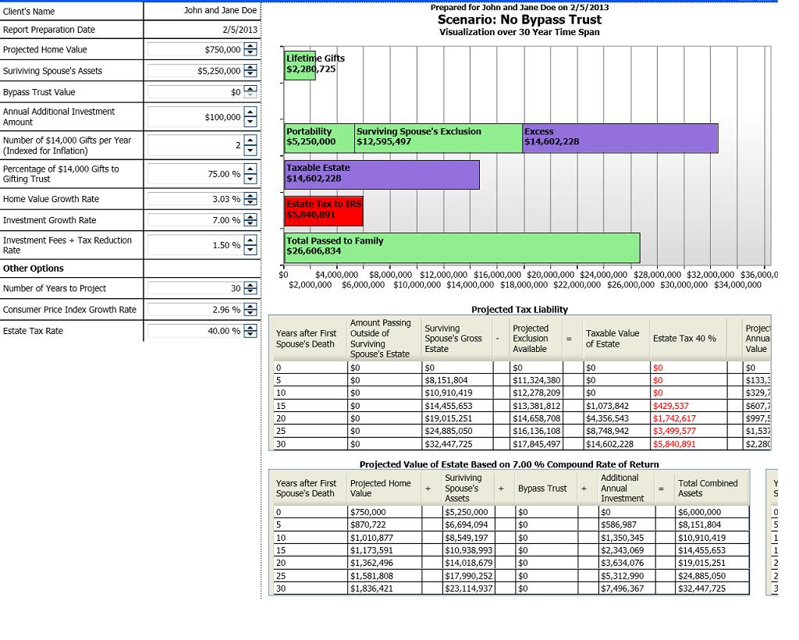
EstateView Planning Software
Copyright © 2013 Gassman Law Associates, P.A.
38
Copyright © 2013 Gassman Law Associates, P.A. EMAIL YOUR QUESTIONS TO: agassman@gassmanpa.com

Slide 39
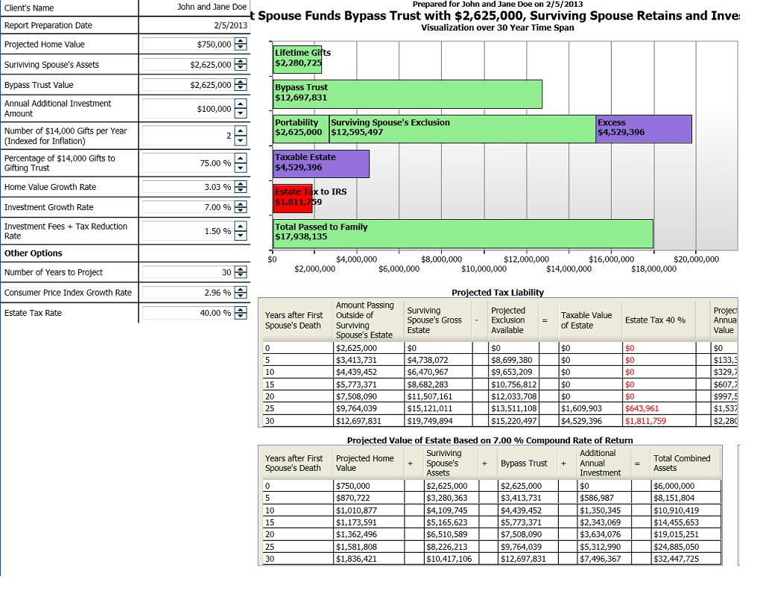
EstateView Planning Software
Copyright © 2013 Gassman Law Associates, P.A.
39
Copyright © 2013 Gassman Law Associates, P.A. EMAIL YOUR QUESTIONS TO: agassman@gassmanpa.com

Slide 40
Bob Burke’s Rule:
For every complex situation there is a
simple answer…and it is the wrong answer.
Complex problems almost always
call for complex solutions.
Copyright © 2013 Gassman Law Associates, P.A. EMAIL YOUR QUESTIONS TO: agassman@gassmanpa.com
40

Slide 41
Credit Shelter Trusts vs. Relying on Exemption Portability
A married couple might provide for all assets to go to the surviving spouse,
or to “lock up” up to $5,250,000 on the first death to facilitate a “credit shelter trust.”
CREDIT SHELTER TRUST
SURVIVING SPOUSE INHERITS ALL ASSETS – USE PORTABILITY OF HIS OR HER $5,250,000 EXEMPTION
1. Uses the first dying spouse’s $5,250,000 Generation Skipping Tax exemption (the ability to benefit children without being taxed at their level) – this is lost if portability is used. | 1. No preservation of first dying spouse’s GST exemption, although a “reverse QTIP” election may be able to be made in some situations to preserve some of the first dying spouse’s GST exemption.
2. Assets can increase in value, to hopefully outpace inflation | 2. No CPI or other value increase after first dying spouse’s death.
3. Better investment opportunities can be channeled to shelter trust assets. | 3. Combined assets will be used to pay personal expenses and to hold “wasting assets.”
4. Co-Trusteeship can require conservatism. | 4. Surviving spouse may lose or give away the assets in remarriage or otherwise.
5. Can be protected from creditors of the surviving spouse. | 5. Not creditor protected.
6. Can borrow money from surviving spouse at the applicable Federal Rate (presently 1.07% for a 9-year Note), and it runs a greater rate of return on its own investment. | 6. No ability to leverage with debt or otherwise.
Copyright © 2013 Gassman Law Associates, P.A. EMAIL YOUR QUESTIONS TO: agassman@gassmanpa.com
41

Slide 42
Primary Reasons to Rely Upon Portability as Opposed to
Full Funding of a Credit Shelter Trust for the Wealthy.
1. Where property that will be eligible for depreciation or may be sold at ordinary rates will likely receive a large step up on the death of the surviving spouse. For example, clients owning a $20,000,000 building subject to $15,000,000 of debt may be best served by assuring that the property will receive a stepped up basis on the surviving spouse’s death, particularly if their family assets are not expected to exceed $10,000,000 in total.
A valuation freeze mechanism may nevertheless be used to help avoid estate tax risk.
2. Where the first dying spouse has significant IRA and pension accounts that constitute the majority of what would be used to fund a Credit Shelter Trust, will the family prefer to have the spousal rollover minimum distribution rules apply on an annually recalculated basis, with no distributions until the surviving spouse has passed age 70 ½?
Planners should also take into account that qualified plan and IRA benefits payable to a credit shelter trust have a net after income tax value that is significantly less than the amounts held under the IRA or qualified plan. Depending upon the life expectancy of the surviving spouse, contemplated payouts, and investment return expectations, portability may be a better alternative than qualified plan funding of a credit shelter trust.
See the attached chart.
3. Do the clients leave everything that would be estate taxable to charity or a charitable foundation?
4. Is there a state inheritance tax situation that would cause payment of taxes on the first death unless portability is used – discussed later in this outline.
NOTE: Update wills to permit the surviving spouse to require the filing of an estate tax return and the making of a portability election.
Copyright © 2013 Gassman Law Associates, P.A. EMAIL YOUR QUESTIONS TO: agassman@gassmanpa.com
42

Slide 43
Three Choices for Retirement Plan Benefits – May Be Best to Have This Spread Among Two of the Choices – Client Age 75 and Oldest Child Age 50
CHOICE #1 | CHOICE #2 | CHOICE #3
Mrs. Client as Beneficiary Advantages: 1) Ability to roll over Dr. Client’s retirement plan accounts income tax-free into her own retirement plan account and to take required minimum distributions based upon her life expectancy, recalculated annually, based upon the below percentages of the retirement plan account for the next ten years. The above referenced distribution percentages are less than what would occur if the retirement plan account was payable to Dr. Client’s Revocable Trust. 2) Mrs. Client has the ability to direct the disposition of the retirement plan funds upon her death, and after Mrs. Client’s death, the required minimum distributions from the retirement plan funds would be based upon the life expectancies of her chosen beneficiaries. The retirement plan funds would be protected from the creditors of these beneficiaries if the funds are paid to trusts for the benefit of such beneficiaries after Mrs. Client’s death. Disadvantages: 1) The future value of the retirement plan would be includable in Mrs. Client’s estate for federal estate tax purposes upon her death. 2) The above referenced distribution percentages are greater than what would occur if the retirement plan accounts were disclaimed so that they are payable to the Client ‘sIrrevocable Trust. 2012: 4.5455% 2013: 4.7170% 2014: 4.9261% 2015: 5.1282% 2016: 5.3476% 2017: 5.5866% 2018: 5.8480% 2019: 6.1350% 2020: 6.4516% | Restated and Amended Trust Agreement of Deceased Client’s Revocable Trust Advantages: 1) The retirement plan accounts can benefit Mrs. Client without being subject to federal estate tax in her estate. 2) Mrs. Client cannot access the retirement plan accounts above the annual required minimum distribution without the consent of the other Co-Trustees, which protects Mrs. Client from any undue influence. 3) The retirement plan benefits would be protected from the creditors of Mrs. Client’s children after her death, except to the extent of any distributions actually made from the Trust to the children. Disadvantages: 1) Annual required minimum distributions would be based upon Mrs. Client’s life expectancy and a special distribution table that is not recalculated annually, which would be as described below for the next ten years. The below referenced distribution percentages are greater than what would occur if either of the two other alternatives were chosen. Thus, by using Mrs. Client’s life expectancy to determine the annual required minimum distributions, the retirement plan benefit distributions cannot be “stretched” out over life expectancies of Mrs. Client’s children after her death. 2) Mrs. Client will have to forfeit her ability to direct the disposition of the retirement plan funds after her death. The retirement plan funds will instead pass in separate trusts for the benefit of Mrs. Client’s children upon her death. 2012: 8.0645% 2013: 8.7719% 2014: 9.6154% 2015: 10.6383% 2016: 11.9048% 2017: 13.5135% 2018: 15.6250% 2019: 18.5185% 2020: 22.7273% | Irrevocable Trust for Children Only Advantages: 1) The value of the retirement plan accounts would not be includable in Mrs. Client’s estate for federal estate tax purposes upon her death. 2) Annual required minimum distributions of retirement plan benefits would be based upon the life expectancy of the oldest of Mrs. Client’s children and a special distribution table that is not recalculated annually, which would be as described below for the next ten years. The above referenced distribution percentages are optimal from an income tax planning standpoint, as they are more favorable than the other alternatives because they result is the lowest annual required minimum distributions. 3) The retirement plan benefits would be protected from the creditors of Mrs. Client’s children after her death, except to the extent of any distributions actually made from the Trust to the children. Disadvantages: 1) Mrs. Client cannot benefit from the retirement plan accounts. 2) Mrs. Client cannot control the disposition of the retirement plan funds upon her death. The retirement plan funds will continue to be held pursuant to the terms of the Trust. 2012: 3.0120% 2013: 3.1056% 2014: 3.2051% 2015: 3.3113% 2016: 3.4247% 2017: 3.5461% 2018: 3.6765% 2019: 3.8168% 2020: 3.9683%
43
Copyright © 2013 Gassman Law Associates, P.A. EMAIL YOUR QUESTIONS TO: agassman@gassmanpa.com

Slide 44
SAMPLE LETTER TO CLIENT IN SECOND MARRIAGE TO SUGGEST UPDATING WILLS TO REQUIRE FIDUCIARIES TO MAKE A PORTABILITY ELECTION AFTER THE FIRST DEATH
_________, 2013
Dear Client with Second Marriage and Portability Concerns:
I am sure that you are aware of the new estate tax law, which provides for a$5,250,000 per person exclusion in 2013, and which will hopefully be extended into 2013 and beyond. I am enclosing literature on the new rules.
The law also provides that if one spouse dies and does not use their $5,250,000 exclusion, then the other spouse has use of any remaining exclusion, but only if a proper estate tax return is filed on the death of the first dying spouse, with a proper election being made.
Where you have children by separate marriages, it is possible that the child or children of the first dying spouse will not want to go to the expense or inconvenience of filing an estate tax return and making this election.
We therefore recommend simple changes to your Wills to explicitly permit the surviving spouse or his or her family to require that this be done.
In addition, we have form language to add to your present Trust to take the new estate tax and possible elimination of estate tax into account, as described in the attached letter.
Please let us know if you would like us to update your documents, which is a very simple and relatively inexpensive process. We can also add language to your present Trust to update for changes made since this was signed, and to take into account the new rules.
I think that it would be advisable for us to get together in person, or at least by phone, to review your assets, liability and insurance logistics in order to make sure that things are properly balanced. We may be able to simplify what you have now, or at least prepare to simplify in the future based upon the changes to the estate tax legislation.
I look forward to hearing from you with respect to this.
Best personal regards,
Alan S. Gassman
44
Copyright © 2013 Gassman Law Associates, P.A. EMAIL YOUR QUESTIONS TO: agassman@gassmanpa.com

Slide 45
Action Checklist for 2013 Estate and Entity/Asset Structuring Update
Review the terms of the client’s revocable living trust to maximize credit shelter trust funding.
  Evaluate what degree of funding on the first death will be necessary in view of portability.
  Should each spouse have a power of appointment over the revocable trust of the other to obtain a full step-up of all assets on death? Review issues associated therewith.
  Consider whether to implement a joint trust with full credit shelter trust funding, and possibly a complete stepped-up basis on all joint assets on the first dying spouse’s death.
  Consider whether to establish a promissory note owed by one spouse to the other’s revocable trust in order to facilitate credit shelter trust funding. Under the OID rules, you have to pay interest or report interest, but it washes on a joint return.
  Consider an Alaska community property trust.
  Wealthier spouse may give less wealthy spouse a power to appoint sufficient assets under wealthier spouse’s revocable trust, exercisable on death of less wealthy spouse, to fund a Credit Shelter Trust with assets held under wealthier spouse’s own revocable trust. See Private Letter Ruling 200403094.
45
Copyright © 2013 Gassman Law Associates, P.A. EMAIL YOUR QUESTIONS TO: agassman@gassmanpa.com

Slide 46
Action Checklist for 2013 Estate and Entity/Asset Structuring Update
Consider strategies to cause a step-up in the income tax basis of assets on the death of a client.
  Determine whether to restructure entities that would cause a valuation discount on death- it may now be preferable to have no discount and a full stepped-up income tax basis for appreciated assets.
  Consider amending operating agreements and partnership agreements to reduce or remove the restrictions that generate discounts so that on the death of the grantor the step-up in basis on these assets will be greater.
  Consider distributing assets out of LLCs or partnerships to the members and partners so gifting trusts established as grantor trusts could possibly get a full step-up in basis on these assets on the death of the grantor.
  Amend revocable trusts to provide that a committee of “independent fiduciaries” could have the power to bestow a general power of appointment on the surviving spouse to cause a step-up in basis on assets that might not otherwise receive such a step-up.
  Consider reforming irrevocable trusts previously established by the client for estate tax avoidance purposes to provide the client with a testamentary general power of appointment or another power over the trust assets that would cause them to be included in his gross estate for estate tax purposes in order to cause a step-up in income tax basis on the death of the grantor.
46
Copyright © 2013 Gassman Law Associates, P.A. EMAIL YOUR QUESTIONS TO: agassman@gassmanpa.com

Slide 47
Action Checklist for 2013 Estate and Entity/Asset Structuring Update
Facilitate having Credit Shelter Trust language be flexible to allow trust assets to be includable in the estate of the surviving spouse to get an income tax basis step-up. Reconsider creditor protection trust planning with the business purpose of funding to complete a gift to take the assets and future growth out of the grantor’s estate, notwithstanding that the grantor may be a discretionary beneficiary. Consider whether to use a trust sitused in an asset protection jurisdiction (such as Nevada, Alaska, Delaware, Belize or the Cook Islands) to hold assets that presently would only be protected under charging order rules. Combine effectiveness of an asset protection trust for credit shelter and protection purposes. Consider implementing a gifting program for the $14,000 annual exclusion allowance, plus the $130,000 exemption increase. Will increased exclusion gifting be done annually, every other year, or at some other regular frequency to avoid having to file gift tax returns every year?
47
Copyright © 2013 Gassman Law Associates, P.A. EMAIL YOUR QUESTIONS TO: agassman@gassmanpa.com

Slide 48
10 YEAR GIFTING PERIOD – ALLOWING GROWTH THEREAFTER
$14,000 ANNUAL EXCLUSION ALLOWANCE
30% VALUATION DISCOUNT
MOVING MORE VALUE OUT OF TAXABLE ESTATES BY USING DISCOUNTED LIMITED PARTNERSHIP OR LLC ANNUAL GIFTING
Year | Reportable Gifting | Cumulative Value with 6% Growth | Gifting Equivalent Amount Applying 30% Discount | Cumulative Value with 6% Growth | Value Added By Discount Phenomenon | 40% Estate Tax Savings (40% of Value Added)
1 | $14,000.00 | $14,000.00 | $20,000.00 | $20,000.00 | $6,000.00 | $2,400.00
2 | $14,000.00 | $28,840.00 | $20,000.00 | $41,200.00 | $12,360.00 | $4,944.00
3 | $14,000.00 | $44,570.40 | $20,000.00 | $63,672.00 | $19,101.60 | $7,640.64
4 | $14,000.00 | $61,244.62 | $20,000.00 | $87,492.32 | $26,247.70 | $10,499.08
5 | $14,000.00 | $78,919.30 | $20,000.00 | $112,741.86 | $33,822.56 | $13,529.02
6 | $14,000.00 | $97,654.46 | $20,000.00 | $139,506.37 | $41,851.91 | $16,740.76
7 | $14,000.00 | $117,513.73 | $20,000.00 | $167,876.75 | $50,363.03 | $20,145.21
8 | $14,000.00 | $138,564.55 | $20,000.00 | $197,949.36 | $59,384.81 | $23,753.92
9 | $14,000.00 | $160,878.42 | $20,000.00 | $229,826.32 | $68,947.90 | $27,579.16
10 | $14,000.00 | $184,531.13 | $20,000.00 | $263,615.90 | $79,084.77 | $31,633.91
11 | $0.00 | $195,603.00 | $0.00 | $279,432.85 | $83,829.86 | $33,531.94
12 | $0.00 | $207,339.18 | $0.00 | $296,198.82 | $88,859.65 | $35,543.86
13 | $0.00 | $219,779.53 | $0.00 | $313,970.75 | $94,191.23 | $37,676.49
14 | $0.00 | $232,966.30 | $0.00 | $332,809.00 | $99,842.70 | $39,937.08
15 | $0.00 | $246,944.28 | $0.00 | $352,777.54 | $105,833.26 | $42,333.30
16 | $0.00 | $261,760.93 | $0.00 | $373,944.19 | $112,183.26 | $44,873.30
17 | $0.00 | $277,466.59 | $0.00 | $396,380.84 | $118,914.25 | $47,565.70
18 | $0.00 | $294,114.58 | $0.00 | $420,163.69 | $126,049.11 | $50,419.64
19 | $0.00 | $311,761.46 | $0.00 | $445,373.51 | $133,612.05 | $53,444.82
20 | $0.00 | $330,467.15 | $0.00 | $472,095.93 | $141,628.78 | $56,651.51
21 | $0.00 | $350,295.18 | $0.00 | $500,421.68 | $150,126.50 | $60,050.60
22 | $0.00 | $371,312.89 | $0.00 | $530,446.98 | $159,134.09 | $63,653.64
23 | $0.00 | $393,591.66 | $0.00 | $562,273.80 | $168,682.14 | $67,472.86
24 | $0.00 | $417,207.16 | $0.00 | $596,010.23 | $178,803.07 | $71,521.23
25 | $0.00 | $442,239.59 | $0.00 | $631,770.84 | $189,531.25 | $75,812.50
26 | $0.00 | $468,773.96 | $0.00 | $669,677.09 | $200,903.13 | $80,361.25
27 | $0.00 | $496,900.40 | $0.00 | $709,857.72 | $212,957.32 | $85,182.93
28 | $0.00 | $526,714.43 | $0.00 | $752,449.18 | $225,734.75 | $90,293.90
29 | $0.00 | $558,317.29 | $0.00 | $797,596.13 | $239,278.84 | $95,711.54
30 | $0.00 | $591,816.33 | $0.00 | $845,451.90 | $253,635.57 | $101,454.23
Copyright © 2013 Gassman Law Associates, P.A. EMAIL YOUR QUESTIONS TO: agassman@gassmanpa.com
48

Slide 49
Action Checklist for 2013 Estate and Entity/Asset Structuring Update
Calendar additional gifts once the gift tax statute of limitations has run on returns filed for large 2011 and 2012 discounted gifts to make use of remaining credit exemption amounts.
Calendar review of possible exercise of powers of appointment?
49
Copyright © 2013 Gassman Law Associates, P.A. EMAIL YOUR QUESTIONS TO: agassman@gassmanpa.com

Slide 50

WHERE DOES THE TRUST FIT IN LOGISTICALLY?
ESTATE AND ASSET PROTECTION PLANNING FOR THE SINGLE PROFESSIONAL
SINGLE (NON-MARRIED) INVIDIDUAL
Child or Children
529 Plans
UGMA Accounts (Subject to Creditors of the Child)
Child’s or Children’s Automobiles?
(Who signed for driving privileges?)
IRA Account Automobile
401k/Pension Account
Annuity Contracts
Life Insurance
Can deposit into a wage account.
HOMESTEAD
Offshore Trust Company, as Trustee or Co-Trustee
Nevada Trust Company, as Co-Trustee
Parent, Trustee
LIVING TRUST
GIFTING TRUST
OFFSHORE ASSET PROTECTION TRUST
NEVADA ASSET PROTECTION TRUST
TRUST FORMED BY CHILD WITH EXCESS ASSETS
3%
3%
99%
97%
97%
S Corporation Stock
1%
PROFESSIONAL PRACTICE CORPORATION
PROFESSIONAL BUILDING AND/OR EQUIPMENT LLC
SECURITIES FLP
REAL ESTATE FLP
WAGE ACCOUNT?
Wages
Long
Term
Lease
Furniture, equipment, accounts receivable
Brokerage Accounts
LLC
LLC
LLC
50
Building 1 Lot 1 Condo 1
Copyright © 2013 Gassman Law Associates, P.A. EMAIL YOUR QUESTIONS TO: agassman@gassmanpa.com

Slide 51
Determining Best How To Allocate Assets As Between A Married Couple
Part I
General Rules:
Typically want each trust funded with at least $5,250,000 worth of assets on death for estate tax planning.
May be funded from ½ of tenancy by the entireties assets via disclaimer and probate or by life insurance/pension/IRA assets.
Trustee other than Husband or Wife
Wife could be Trustee if Husband is sole grantor (or vice versa)
Husband
Wife
Protected life insurance and annuity contracts “owned by the insured.”
Husband’s Revocable Trust
Wife’s Revocable Trust
Gifting Trust (Irrevocable)
Lifetime By-Pass Trust (Irrevocable)
FLORIDA TBE
(Tenancy by the Entireties)
Assets held directly by revocable trust are subject to husband’s creditor claims.
Direct ownership of limited partnership or LLC not in TBE may have charging order protection (meaning that if a creditor obtains a lien on the limited partnership or LLC, the husband cannot receive monies from the limited partnership or LLC without the creditor being paid).
Only exposed to creditors if both spouses owe the creditor, if one spouse dies and the surviving spouse has a creditor, the spouses divorce, or state law or the state of residence changes.
2. On death of one spouse, surviving spouse may disclaim up to ½ (if no creditor is pursuing the deceased spouse) to fund By-Pass Trust on first death.
Safe from creditors of husband but exposed to creditors of wife (Maintain large umbrella liability insurance coverage to protect these assets.)
On wife’s death, can be held under a protective trust, which will continue to be safe from creditors of husband, subsequent spouses, and “future new family.”
Safe from creditors of both spouses.
If divorce occurs, should not be subject to rules for division of property between spouses.
May be controlled by the “entrepreneurial spouse” by using a Family Limited Partnership.
1. Safe from the creditors of the Grantor’s spouse.
2. If funded by one spouse, may benefit other spouse and children during the lifetime of both spouses.
3. Otherwise can be identical to gifting trust pictured to the left.
SEE NEXT PAGE FOR SECOND TIER PLANNING
A COMMON SOLUTION - to use a limited partnership or similar mechanisms and have no assets directly in the “high risk” spouse’s trust, half to two-thirds of the assets held as tenants by the entireties, and half to two-thirds of the assets directly in the “low risk” spouse’s trust.
51
Copyright © 2013 Gassman Law Associates, P.A. EMAIL YOUR QUESTIONS TO: agassman@gassmanpa.com

Slide 52
Determining Best How To Allocate Assets As Between A Married Couple
Part II
Subsidiary Entity Techniques:
Limited partnerships and LLCs can be used to facilitate discounts, for estate tax purposes, and for charging order protection.
Limited partnerships and LLCs can also be used to provide “firewall protection” from activities or properties owned.
Wife could be Trustee if Husband is sole grantor (or vice versa)
Husband
Wife
Trustee other than Husband or Wife
Husband’s Revocable Trust
Wife’s Revocable Trust
Gifting Trust (Irrevocable)
Lifetime By-Pass Trust (Irrevocable)
FLORIDA TBE
(Tenancy by the Entireties)
Assets held directly by revocable trust are subject to husband’s creditor claims.
Direct ownership of limited partnership or LLC not in TBE may have charging order protection (meaning that if a creditor obtains a lien on the limited partnership or LLC, the husband cannot receive monies from the limited partnership or LLC without the creditor being paid).
Only exposed to creditors if both spouses owe the creditor, if one spouse dies and the surviving spouse has a creditor, the spouses divorce, or state law or the state of residence changes.
2. On death of one spouse, surviving spouse may disclaim up to ½ (if no creditor is pursuing the deceased spouse) to fund By-Pass Trust on first death.
Safe from creditors of husband but exposed to creditors of wife (Maintain large umbrella liability insurance coverage to protect these assets.)
On wife’s death, can be held under a protective trust, which will continue to be safe from creditors of husband, subsequent spouses, and “future new family.”
Safe from creditors of both spouses.
If divorce occurs, should not be subject to rules for division of property between spouses.
May be controlled by the “entrepreneurial spouse” by using a Family Limited Partnership.
1. Safe from the creditors of the Grantor’s spouse.
2. If funded by one spouse, may benefit other spouse and children during the lifetime of both spouses.
3. Otherwise can be identical to gifting trust pictured to the left.
97%
3%
1%
96%
3%
Husband, Manager
100%
FLP
FLP
LLC
SECOND TIER PLANNING:
FIREWALL LLC
Leveraged Investment
Property or activity
A COMMON SOLUTION - to use a limited partnership or similar mechanisms and have no assets directly in the “high risk” spouse’s trust, half to two-thirds of the assets held as tenants by the entireties, and half to two-thirds of the assets directly in the “low risk” spouse’s trust.
52
Copyright © 2013 Gassman Law Associates, P.A. EMAIL YOUR QUESTIONS TO: agassman@gassmanpa.com

Slide 53
Action Checklist for 2013 Estate and Entity/Asset Structuring Update
Lock in discounts now on remaining entity interests by installment sale, GRAT or CLAT transactions, just in case the administration eliminates discounts.
53
Copyright © 2013 Gassman Law Associates, P.A. EMAIL YOUR QUESTIONS TO: agassman@gassmanpa.com

Slide 54
$1,000,000 PROMISSORY NOTE/SCIN/PRIVATE ANNUITY/GRAT ALTERNATIVES
FEBRUARY 2013
CLIENT AGE 73
Alternatives: (Using December 2012 Applicable Federal Rate, January 2013 Applicable Federal Rate and February 2013 7520 Rate)
CLIENT
(AGE 73)
<3 Year Interest Only Installment Note @ .21% - Payment = $2,100 per year*
TRUST (PURCHASER)
9 Year Interest Only Installment Note @ .87% - Payment = $8,700 per year*
>9 Year Interest Only Installment Note @ 2.31% - Payment = $23,100 per year*
12 Year Interest Only SCIN @ 6.587% - Payment = $65,866 per year*
Private Annuity Level Annual Payment - Payment = $89,736 per year*
3 Year Level Payment GRAT @ 1.2% - Payment = $339,660 per year*
**3 Year GRAT @ 1.2% - Initial Payment = $280,345 and Increases Annually by 20%
* Notes would have no penalty for prepayment – minimum payments are shown above.
Self-cancelling installment Notes must balloon before life expectancy as measured at time of Note being made. John Smith’s life expectancy is 12.33 years under IRS tables.
The SCIN calculations above are based on a 12-year note term.
** This GRAT assumes that each annuity payment will increase by 20% each year.
All GRATs assume a taxable gift of approximately $5,000.00 on funding
Note: February 2013 rates for annual compounding are:
Short-Term -- .21%
Mid-Term – 1.01% Usable through April 30, 2013
Long-Term – 2.52%
54
Copyright © 2013 Gassman Law Associates, P.A. EMAIL YOUR QUESTIONS TO: agassman@gassmanpa.com

Slide 55
Action Checklist for 2013 Estate and Entity/Asset Structuring Update
Consider toggling off the grantor trust status of some irrevocable trusts so that the income of the trust will no longer be taxable to the grantor but instead will be taxable to the beneficiaries of the trust.
If you are going to toggle off the grantor trust status of a trust, have the grantor replace the low basis assets of the trust with high basis assets before the status of the trust is changed.
Reduce life insurance coverages that might not be necessary due to the increased estate tax exclusion.
55
Copyright © 2013 Gassman Law Associates, P.A. EMAIL YOUR QUESTIONS TO: agassman@gassmanpa.com

Slide 56
WHAT TO DO WITH LIFE INSURANCE THAT WAS ACQUIRED TO REPLACE ESTATE TAX LOSSES: TIME TO DROP THIS COVERAGE OR STOP MAKING PAYMENTS FOR NOW?
This can be a complicated question. Many clients have purchased second-to-die or individual life insurance policies, and have placed them under life insurance trusts to facilitate having value to replace the federal estate tax. No one is able to predict what may happen with the estate tax law in 2013 or thereafter, but if the exclusions remain at $5,250,000 per person and continue to be adjusted for CPI, we expect many taxpayers will no longer find it worthwhile to pay premiums in exchange for life insurance death benefits that they will never live to enjoy.
On the other hand, life insurance proceeds can still be useful to family members, and even if the federal estate tax disappears or even remains at $5,250,000 per person exclusions, future legislation could always modify these provisions.
Some clients have flexible permanent life insurance policies, under which they face negligible negative consequences if they stop making premium payments for a year or two. The insurance carrier can determine what the financial repercussions will be if the client skips a year or two of payments, so the client can decide whether it is worthwhile to do so.
Some clients have guaranteed premium products, where notwithstanding a policy’s performance, the carrier agrees to pay the death benefit as long as all premiums are timely paid. Policyholders should not skip premium payments on these products, which have been offered by many carriers, including John Hancock, Pacific Mutual, and ING.
Many life insurance policies have significant surrender charges, and clients are disappointed to find that when they cash the policies in, they receive much less than they paid in premiums over the years. As a result, families are often best served by reducing the death benefit of a policy in lieu of terminating it. Then the cash value existing in the policy can grow, or at least reduce the rate of depletion, to have the best possible expected future value for the family.
Many life insurance policies have a feature whereby the dividends earned within the policy are applied to purchase more life coverage, so the death benefit increases gradually each year. A carrier or agency can forecast what the premiums and/or cash value amounts under the policy will be if the death benefit no longer increases, by reason of paid up additions being applied to reduce premiums or increase cash values.
Clients whose health has declined since acquiring policies might consider selling them to viatical organizations, which commonly purchase these though the same licensed agents who sold them to the client in the first place.
56
Copyright © 2013 Gassman Law Associates, P.A. EMAIL YOUR QUESTIONS TO: agassman@gassmanpa.com

Slide 57
BUYING CONVERTIBLE TERM INSURANCE
You can ask an independent agent who writes for many carriers to have the client take the physical so that they can get quotes from several carriers.
You can ask that all results and quotes be confidential and not given to the bureau that all carriers belong to and share information with. Once a carrier turns the client down or "rates" the client all other carriers know.
This is called an "informal application" and then the carriers can each give informal quotes for term coverage. If the client likes the quote then he or she can buy it.
You might spread this among 2 or 3 carriers in case one goes under.
Sample term rates for "preferred", "standard" and "standard smoker" individuals at ages 35, 40, 45, 50 and 55 are as follows:
57
Copyright © 2013 Gassman Law Associates, P.A. EMAIL YOUR QUESTIONS TO: agassman@gassmanpa.com

Slide 58
BUYING TERM INSURANCE
AGE 30
 | PREFERRED |  | STANDARD |  | STANDARD SMOKER
 | MALE | FEMALE | MALE | FEMALE | MALE | FEMALE
10 Year Term | $378 | $328 | $658 | $518 | $1,548 | $1,218
15 Year Term | $458 | $398 | $768 | $688 | $1,918 | $1,438
20 Year Term | $608 | $478 | $968 | $738 | $2,278 | $1,638
30 Year Term | $938 | $768 | $1,518 | $1,218 | $3,908 | $3,018
AGE 35
 | PREFERRED |  | STANDARD |  | STANDARD SMOKER
 | MALE | FEMALE | MALE | FEMALE | MALE | FEMALE
10 Year Term | $375 | $345 | $735 | $565 | $1,685 | $1,345
15 Year Term | $515 | $415 | $915 | $805 | $2,135 | $1,775
20 Year Term | $665 | $565 | $1,105 | $945 | $2,885 | $2,265
30 Year Term | $1,015 | $825 | $1,735 | $1,375 | $4,705 | $3,555
58
Copyright © 2013 Gassman Law Associates, P.A. EMAIL YOUR QUESTIONS TO: agassman@gassmanpa.com

Slide 59
BUYING TERM INSURANCE
AGE 40
 | PREFERRED |  | STANDARD |  | STANDARD SMOKER
 | MALE | FEMALE | MALE | FEMALE | MALE | FEMALE
10 Year Term | $505 | $435 | $925 | $785 | $2,405 | $2,005
15 Year Term | $655 | $575 | $1,215 | $1,035 | $3,125 | $2,485
20 Year Term | $865 | $745 | $1,505 | $1,255 | $4,345 | $3,185
30 Year Term | $1,495 | $1,135 | $2,465 | $1,985 | $7,175 | $5,275
AGE 45
 | PREFERRED |  | STANDARD |  | STANDARD SMOKER
 | MALE | FEMALE | MALE | FEMALE | MALE | FEMALE
10 Year Term | $805 | $705 | $1,405 | $1,095 | $8,935 | $3,055
15 Year Term | $1,065 | $875 | $1,985 | $1,445 | $5,275 | $3,815
20 Year Term | $1,415 | $1,105 | $2,355 | $1,755 | $7,195 | $4,895
30 Year Term | $2,355 | $1,765 | $2,845 | $2,825 | $11,625 | $7,555
59
Copyright © 2013 Gassman Law Associates, P.A. EMAIL YOUR QUESTIONS TO: agassman@gassmanpa.com

Slide 60
BUYING TERM INSURANCE
AGE 50
 | PREFERRED |  | STANDARD |  | STANDARD SMOKER
 | MALE | FEMALE | MALE | FEMALE | MALE | FEMALE
10 Year Term | $1,235 | $1,025 | $2,145 | $1,625 | $6,435 | $4,295
15 Year Term | $1,785 | $1,235 | $2,805 | $2,065 | $7,825 | $5,725
20 Year Term | $2,225 | $1,625 | $3,425 | $2,715 | $10,425 | $6,865
30 Year Term | $4,025 | $2,645 | $6,245 | $4,785 | $13,719 | $10,109
AGE 55
 | PREFERRED |  | STANDARD |  | STANDARD SMOKER
 | MALE | FEMALE | MALE | FEMALE | MALE | FEMALE
10 Year Term | $2,025 | $1,495 | $3,315 | $2,235 | $8,935 | $5,905
15 Year Term | $2,895 | $1,835 | $4,655 | $2,985 | $12,055 | $7,995
20 Year Term | $3,505 | $2,465 | $5,955 | $3,985 | $14,875 | $9,985
30 Year Term | Not Available | Not available | Not Available | Not Available | Not Available | Not Available
AGE 60
 | PREFERRED |  | STANDARD |  | STANDARD SMOKER
 | MALE | FEMALE | MALE | FEMALE | MALE | FEMALE
10 Year Term | $3,098 | $2,198 | $4,808 | $3,278 | $13,028 | $8,308
15 Year Term | $4,488 | $3,048 | $7,088 | $5,218 | $17,658 | $12,978
20 Year Term | $5,798 | $4,078 | $9,488 | $6,668 | $22,048 | $15,058
30 Year Term | Not Available | Not Available | Not Available | Not Available | Not Available | Not Available
Copyright © 2013 Gassman Law Associates, P.A. EMAIL YOUR QUESTIONS TO: agassman@gassmanpa.com
60

Slide 61
Action Checklist for 2013 Estate and Entity/Asset Structuring Update
Realize that real estate can go up in value again and plan for ownership of homes in various trust systems.
Run through the possible financial and tax implications of real estate values recovering, particularly for clients with substantially leveraged real estate- is it time to gift to a Nevada trust?
61
Copyright © 2013 Gassman Law Associates, P.A. EMAIL YOUR QUESTIONS TO: agassman@gassmanpa.com

Slide 62
QPRT Trust Planning Demonstration
Age of Client 68
Initial Value of Home $860,000
Fractional Discount Assumed 15.00%
Discounted Value of ½ of Home $365,500
 | Gift Component (with respect to each QPRT) |  | Value of ½ of Home at End of QPRT Term Assuming 7% Growth | Estate Tax on Value at End of Term Assuming 35% Estate Tax Rate | Estate Tax Savings on ½ of Home at End of QPRT | Estate Tax Savings on Entire Value of Home at End of QPRT | Estate Tax Savings After 16 Years Assuming 7% Growth on ½ of House | Estate Tax Savings After 16 Years Assuming 7% Growth on Entire House
6 Year QPRT | Gift % | 73.220% | $645,314.05 | $225,859.92 | $132,193.23 | $264,386.96 | $350,633.96 | $701,267.92
 | Value of Gift | $267,619.00
8 Year QPRT | Gift % | 64.328% | $738,820.06 | $258,587.02 | $176,295.43 | $352,590.85 | $362,009.05 | $724,018.10
 | Value of Gift | $235,118.84
10 Year QPRT | Gift % | 55.528% | $845,875.08 | $296,056.28 | $225,022.09 | $450,044.17 | $373,266.45 | $746,532.90
 | Value of Gift | $202,954.84
12 Year QPRT | Gift % | 46.916% | $968,442.38 | $338,954.83 | $278,937.54 | $557,875.08 | $384,283.35 | $768,566.70
 | Value of Gift | $171,477.98
14 Year QPRT | Gift % | 38.633% | $1,108,769.68 | $388,069.39 | $338,648.12 | $677,296.25 | $394,879.38 | $789,758.76
 | Value of Gift | $141,203.62
16 Year QPRT | Gift % | 30.840% | $1,269,430.41 | $444,300.64 | $404,848.70 | $809,697.15 | $404,848.57 | $809,697.15
 | Value of Gift | $112,720.20
Probability of Death Before Certain Age
Current Age 68
2 years (70) 4.18% 6 years (74) 14.31% 10 years (78) 27.33% 20 years (88) 68.53%
4 years (72) 8.92% 8 years (76) 20.45% 15 years (83) 47.24%
62

Slide 63
Child’s Homestead Irrevocable Trust
A trust that can own a home used by a child to benefit the spouse and descendants;
- can qualify for the State Homestead Exemption and 3% cap
- can be considered as owned by the Child for income tax purposes to qualify for the $250,000 income tax exemption on sale
- can be controlled by the Trustee and used for the benefit of various family members
- will insulate family members from liabilities associated with ownership of the home
Other Spouse = Trustee
Trust assets can be applied for the health, education, maintenance and support of the Trustee-Spouse and children.
One or more children may reside in the house to qualify for the Florida Tax Homestead Exemption.
For income tax purposes, the Trust can be considered as owned by the child who lives in the house so that the house can be sold income tax free to the extent of up to $250,000 in appreciation.
The Trust will not be subject to creditor claims of any family member unless (1) the transfer to the Trust by the Grantor Spouse is a “fraudulent transfer,” or (2) the child has a right to withdraw more than the gift tax exclusion amount in any calendar year.
NOTE – The Trust must be appropriately drafted, funded, and administered to achieve the above results.
CHILD’S HOMESTEAD IRREVOCABLE TRUST
GRANTOR
SPOUSE
Gift
Home and Other Assets
63
Copyright © 2013 Gassman Law Associates, P.A. EMAIL YOUR QUESTIONS TO: agassman@gassmanpa.com

Slide 64
Limited Liability Trust –
Asset Protection Trust
Trust Company in proper jurisdiction = Trustee or Co-Trustee
ASSET PROTECTION TRUST
Benefits mother, father and children.
May be disregarded for income tax purposes.
No tax filing requirements if a domestic asset protection trust jurisdiction is used.
May need to have subsidiary management trust owned 100% by asset protection trust to hold title, to allow parents to have management powers (preferably one parent who does not have other exposed assets).
Mother & Father as contributors
Rental Home(s)
64
Copyright © 2013 Gassman Law Associates, P.A. EMAIL YOUR QUESTIONS TO: agassman@gassmanpa.com

Slide 65
COMPARISON OF METHODS TO PURCHASE HOMES FOR THE CHILDREN
 | $250,000 Exemption on Sale of Home | $50,000 Homestead Exemption and 3% Per Year Cap on Valuation | Divorce | Control | Notes
Father and Mother loan money to the child. Child purchases and owns home. | Child gets income tax exemption. | Child gets homestead exemption and cap. | Loan will be repaid to parents. Equity may be subject to claim by spouse if this is not waived by Prenuptial Agreement. | Child controls the house. However, we may be able to call the Note to force a sale. | Note: Child gets equity above Note.
Father and Mother own the home and the child lives in the house. | No. | Generally no. However, it may be possible to obtain these with a 99-year lease. | Better protected. | Father and Mother control.
Via Child Funded Homestead Bypass Trust. | Child gets income tax exemption. | Child gets homestead exemption and cap. | Better protected. | Mother would be Trustee of the Trust and would retain control. | Note: Creditors may be able to get into the Trust. It may be possible for Mother to transfer the house to the child’s individual name in the event of a Creditor issue.
Direct Client Funded Homestead Bypass Trust. | No | Child gets homestead exemption and cap. | Better protected. | Mother would be Trustee of the Trust and would retain control. | Note: The $250,000 exemption is lost, but no creditor of the child should be able to get the assets.
One-half purchased by child and one-half owned by Father and Mother. | One-half. | One-half. | One-half, better protected. | Each controls one-half.
65
Copyright © 2013 Gassman Law Associates, P.A. EMAIL YOUR QUESTIONS TO: agassman@gassmanpa.com

Slide 66
Action Checklist for 2013 Estate and Entity/Asset Structuring Update
Clean-up time:
Forgive or reduce intra-family and inter-trust loans. (May be best to gift cash to the borrowing entity and let the borrowing entity use that cash to repay the loan – report a cash gift on the tax return.)
Pay off loans that may have been taken out on life insurance policies that are owned by irrevocable trusts or family. (Or is it best to keep a low interest loan or grandfathered split dollar arrangement in place and to use gifting allowances elsewhere?)
c. Have children who own life insurance policies on their parents use part of their own $5,250,000 lifetime gifting exclusions to gift such policies to trusts, to preserve policy proceeds from potential future creditors, divorce, or unwise management or spending.
d. Fund irrevocable trusts that may buy out remainder interests, purchase existing Grantor Retained Annuity Trusts (“GRATs”) assets, purchase homes from Qualified Personal Residence Trusts (“QPRTs”), or otherwise assist in unwinding or unfreezing mechanisms and arrangements now in place.
e. Make further ballast gifts to irrevocable trusts which owe installment notes and are highly leveraged, due to reduction in values given the post-2007 economic circumstances.
66
Copyright © 2013 Gassman Law Associates, P.A. EMAIL YOUR QUESTIONS TO: agassman@gassmanpa.com

Slide 67
Action Checklist for 2013 Estate and Entity/Asset Structuring Update
Good reasons for Floridians to get divorced:
  Each spouse could have a separate creditor protection homestead.
  Each spouse could become the head of household for wage exemption purposes for creditor protection as long as they each support someone else in their household- thus a reason to date after the divorce.
  Under the 2013 Medicare tax rules, a married couple will be responsible for the 3.8% tax on all investment income to the extent that their taxable income exceeds $250,000.
  This threshold is $200,000 per person for an unmarried couple, so a $400,000 effective threshold can apply.
  Each spouse can remarry an individual who has large net operating losses and then give that person a salary to absorb the net operating losses while sharing the income.
  Have your present spouse use their entire $5,250,000 gifting allowance on the children and then divorce them and marry a new spouse with a full $5,250,000 allowance and assure life expectancy.
67
Copyright © 2013 Gassman Law Associates, P.A. EMAIL YOUR QUESTIONS TO: agassman@gassmanpa.com

Slide 68
Tax Advantaged Assets That Provide Creditor Protection
Annuities
Dividends paid to tenants by the entireties – place medical practices into TBE.
Home interest deduction more valuable.
Deducting the car.
68
Copyright © 2013 Gassman Law Associates, P.A. EMAIL YOUR QUESTIONS TO: agassman@gassmanpa.com

Slide 69
To view this webinar and download the accompanying materials please visit:
www.gassmanlawassociates.com/webinarlibrary.html

Slide 71
HADDON HALL PUBLISHING PRESENTS THE FOLLOWING BOOKS FOR PHYSICIANS:
To order either of the above books for a special rate of $1.99 for electronic and $9.99 printed, please email janine@gassmanpa.com
71
Copyright © 2013 Gassman Law Associates, P.A. EMAIL YOUR QUESTIONS TO: agassman@gassmanpa.com

Slide 72
HADDON HALL PUBLISHING PRESENTS THE FOLLOWING BOOKS FOR PHYSICIANS:
To order either of the above books for a special rate of $1.99 for electronic and $9.99 printed, please email janine@gassmanpa.com
72
Copyright © 2013 Gassman Law Associates, P.A. EMAIL YOUR QUESTIONS TO: agassman@gassmanpa.com

Slide 73
GASSMAN LAW ASSOCIATES, P.A. presents
The Physicians Guide to the
2013 Tax Laws
Monday, February 11, 2013
5:00 p.m.
Alan S. Gassman, J.D., LL.M.
agassman@gassmanpa.com
73

Slide 74
Gassman Law Associates, P.A. Lawyer Biographies
Alan S. Gassman, J.D., LL.M. is a practicing lawyer and author based in Clearwater, Florida. Mr. Gassman is the founder of the firm Gassman Law Associates, P.A., which focuses on the representation of physicians, high net worth individuals, and business owners in estate planning, taxation, and business and personal matters. He is the lead author on Bloomberg BNA’s Estate Tax Planning and 2011 and 2012, Creditor Protection for Florida Physicians, Gassman & Markham on Florida and Federal Asset Protection Law, A Practical Guide to Kickback and Self-Referral Laws for Florida Physicians, The Florida Physician Advertising Handbook and The Florida Guide to Prescription, Controlled Substance and Pain Medicine Laws, among others. Mr. Gassman is a frequent speaker for continuing education programs, publishes regularly for Bloomberg BNA Tax & Accounting, Estates and Trusts Magazine, Estate Planning Magazine and Leimberg Estate Planning Network (LISI). He holds a law degree and a Masters of Law degree (LL.M.) in Taxation from the University of Florida, and a business degree from Rollins College. Mr. Gassman is board certified by the Florida Bar Association in Estate Planning and Trust Law, and has the Accredited Estate Planner designation for the National Association of Estate Planners & Councils. Mr. Gassman’s email is Agassman@gassmanpa.com.
Thomas J. Ellwanger, J.D., is a lawyer practicing at the Clearwater, Florida firm of Gassman Law Associates, P.A. Mr. Ellwanger received his B.A. in 1970 from Northwestern University and his J.D. with honors in 1974 from the University of Florida College of Law. His practice areas include estate planning, trust and estate administration, personal tax planning and charitable tax planning. Mr. Ellwanger is a member of the American College of Trusts and Estates Council (ACTEC). His email address is tom@gassmanpa.com
Kenneth J. Crotty, J.D., LL.M. is a partner at the Clearwater, Florida firm of Gassman Law Associates, P.A., where he practices in the areas of estate tax and trust planning, taxation, physician representation, and corporate and business law. Mr. Crotty has co-authored several handbooks that have been published in BNA Tax & Accounting, Estate Planning, Steve Leimberg’s Estate Planning and Asset Protection Planning Newsletter, Estate Planning magazine, and Practical Tax Strategies. Mr. Crotty is also the author of the Limited Liability Company Chapter of the Florida Bar’s Florida Small Business Practice, Seventh Edition. He, Alan Gassman, and Chrisopher Denicolo are the co-authors of the BNA book “Estate Tax Planning in 2011 & 2012”. His email address is Ken@gassmanpa.com.
Christopher Denicolo, J.D., LL.M. is a partner at the Clearwater, Florida law firm of Gassman Law Associates, P.A., where he practices in the areas of estate tax and trust planning, taxation, physician representation, and corporate and business law. He has co-authored several handbooks that have been featured in Bloomberg BNA Tax & Accounting, Steve Leimberg’s Estate Planning and Asset Protection Planning Newsletter, and the Florida Bar Journal. He is also the author of the Federal Income Taxation of the Business Entity Chapter of the Florida Bar’s Small Business Practice, Seventh Edition. Mr. Denicolo received his B.A. and B.S. degrees from Florida State University, his J.D. from Stetson University College of Law, and his LL.M. (Estate Planning) from the University of Miami. His email address is Christopher@gassmanpa.com
74
Copyright © 2013 Gassman Law Associates, P.A. EMAIL YOUR QUESTIONS TO: agassman@gassmanpa.com

