Slide 1
50 WAYS TO LEAVE YOUR OVERHEAD
Saturday, July 20, 2013
11:40 am – 12:40 pm
Alan S. Gassman, J.D., LL.M.
agassman@gassmanpa.com
and
Kevin Bassett, CPA
kbassett@mindspring.com
Notes:
Thank you _______. It is an honor and privilege to be presenting at today's Tampa Bay MGMA meeting. I know we have had a lot of well respected lawyers on the program recently. We have had Cynthia Mikos, Mary Li Casey, Gary Walker and Joe Rugg all present over the last year. So when I was putting together this presentation I thought "I like lawyers, at least when they are not suing me". So I decided to bring my favorite lawyer Alan Gassman.

Slide 2
“DR. SMITH”
2
Dr. Smith was a private physician,
Who enjoyed his ownership position
He helped lots of folks, and told corny jokes
And he loved the small practice tradition.
One day Dr. Smith became worried,
‘Tween exam rooms and meetings he hurried.
Hospitals and Wall Street spread sleet on Doctor Street
So towards a big organization he scurried.
They lured him in with the illusion
That 2013 would bring much confusion
And that working for the administrator (who reminded him of Darth Vader)
Was the way to avoid destitution.
So along with his Hippocratic brothers,
He succumbed to the cash of another,
And now complete, with a non compete,
He serves the system that wobbles asunder.
While his independent competitors
Are still their own bosses and editors,
They earn more rewards, having stayed their own lords,
And continue to support their Senators.
The new system fails and sputters,
And the Wall Street mantra stutters,
The lights go out, the executives pout,
And Dr. Smith is looking hard at the gutter.
So he buys his non-compete,
And starts over back on his old street,
In his clinic near town, he rebuilds from the ground,
And the cycle for him is complete.
Was it worth the sense of security,
To act with such prematurity,
Had there been time to think, and a more secure link
The machine would have had much less false lure-ity.
T.S. Opiate, 2010
Notes:
Let us have a hand for accomplished poet.
I told you this would be different.
Just like during the Renaissance, our world is changing, rapidly. However, I would not necessarily consider this a Renaissance. For medical group management. As you know, the Renaissance. Came after the dark ages and things definitely got better in the world.
Today, it seems like we are returning to the feudal system and doctors are now becoming serfs. If doctors are becoming serfs where does that leave us in the food chain?

Slide 3
Doctor Looks at 40
Based on the Jimmy Buffet song “A Pirate Looks at 40”
By: Alan (“Drake Fierce Stubble”) Gassman and Fred (“Lackey Phil the Brown”) Simmons
3
Mr. Hospital Administrator, I have heard you call.
I have wanted to have another large sum of cash
Since I attended my first hospital ball.
That says it all, that says it all.
I’ve watched you try to control me,
Switched from cost to DRG.
In your records and foundations,
You hold treasures few have seen.
It’s like a bad dream, and really obscene.
Yes I am a doctor, 20 years too late.
The ancillaries don’t thunder, specialists don’t plunder,
I'm an SGR victim of fate.
Arriving too late, arriving too late.
I've done a bit of dealing, I fell hard for the cash.
The ACO promise could have bought me Miami,
But I skimmed the fine print too fast.
Never meant to last, never meant to last.
I have been your slave for roughly two weeks,
Passed out and I rallied and I feel pretty meek.
But I've got to stop wishin', I've got to start fishin',
For a way to start my practice again.
And I’ve lost a few friends, I’ve lost a few friends.
I know a younger doctor,
That I might have to work for awhile.
The hospital might run me away, but then later I can stay,
And in two years I’ll be able to smile.
Will just take awhile, like crawling a mile.
Mr. Hospital Administrator, after a few months I have found,
Selling my practice was not a good plan,
And I can’t live on MGMA 50th percentile,
Feel like I've drowned, and to a non compete I’m bound,
Dressed like a clown, handcuffed and bound.

Slide 4
Recent integration history.
4
  Late 1980s – Hospital buying primary-care practices.
  Early 1990s – Physician Practice Management Companies (PPMCs) / Wall Street buying practices.
  Mid-1990s – Physician Hospital Organizations (PHOs).
  Late 1990s – Independent Practice Association (IPA) Networks.
Notes:
Continuing the Enlightenment, I am the renaissance man of history.
And I will review the recent history of medical group integration.

Slide 5
5
“Those who cannot remember the past are condemned to fulfill it”.
“Reasons In Common Sense”, Vol. 1 (1905)
George Satayana
Spanish American Philosopher
Notes:
I am also the renaissance man of philosophy.
I am reminded of the often miss quoted quote from the great Spanish-American philosopher George Santayana.
You often hear him quoted as “those who cannot remember the past are condemned to relive it”.
But being a true historical perfectionist I must tell you that the actual quote is

Slide 6
Factors driving current integration activities:
6
  Healthcare reform.
  Accountable Care Organizations (ACOs).
  Fear, confusion and bad advice.
  Physician compensation declining.
  Ancillary revenue declining.
  Inability to recruit due to compensation.
  Physicians leaving due to compensation.
  Pressure from referral base / access to hospital employed primary care physicians.
  Lack of capital.
Notes:
There are many factors driving the current integration trend.

Slide 7
Factors driving current integration activities (cont’d.):
7
  J. Regulatory constraints and compliance.
  Practice cultural changes including younger physicians desiring a more balanced lifestyle that includes more vacation and family time.
  Call challenges.
  Lack of strategic vision.
  Lack of physician leadership.
  Lack of entrepreneurial spirit among the physicians.
Notes:
Are these factors affecting your practices?

Slide 8
MGMA Medical Groups by Ownership
8
Percent of MGMA Medical Groups by Ownership | MGMA Member Organizations 2010 | MGMA Member Organizations 2003 | Change in MGMA Member Organizations 2003 – 2010
Physician Owned | 80.7% | 83.2% | -3.0%
Hospital Owned | 11.6% | 8.3% | 40.0%
Other Ownership | 7.7% | 8.5% | -9.5%
All Medical Groups | 100.0% | 100.0% | 0.0%
Source: Medical Group Management Association “Changes in Ownership for MGMA Practices 2003 – 2010”.
Copyright 2011, Medical Group Management Association. Used with Permission.
Notes:
Our parent organization, MGMA shows us that the percentage of hospital owned practices is increasing rapidly while physician ownership of medical practices is declining.
While the raw percentage of MGMA medical practices is not that significant at 11.6%, the increase in seven years is 40%.

Slide 9
9
MGMA Physicians by Ownership
Percent of MGMA Medical Group Physicians by Ownership | MGMA Member Group Physicians 2010 | MGMA Member Group Physicians 2003 | Change in MGMA Member Group Physicians 2003 – 2010
Physician Owned | 44.6% | 43.6% | 2.1%
Hospital Owned | 28.1% | 17.0% | 65.1%
Other Ownership | 27.3% | 39.3% | -30.5%
All Medical Groups | 100.0% | 100.0% | 0.0%
Source: Medical Group Management Association “Changes in Ownership for MGMA Practices 2003 – 2010”.
Copyright 2011, Medical Group Management Association. Used with Permission.
Notes:
The changes even more striking when we count the number of MGMA physicians in hospital owned practices versus physician owned practices.
I believe the other ownership decline relates primarily to the fall of the PPMC industry I discussed earlier.

Slide 10
MGMA Group Size by Ownership
10
Mean Size (FTE Physicians) of Medical Group by Ownership | Mean Number of FTE Physicians 2010 | Mean Number of FTE Physicians 2003 | Change in Mean Number of FTE Physicians 2003 – 2010
Physician Owned | 19.5 | 16.4 | 19.1%
Hospital Owned | 85.8 | 64.3 | 33.6%
All Medical Groups | 32.2 | 25.5 | 26.5%
Source: Medical Group Management Association “Changes in Ownership for MGMA Practices 2003 – 2010”.
Copyright 2011, Medical Group Management Association. Used with Permission.
Notes:
This slide shows MGMA group size by ownership and it is obvious that the hospital owned groups are much larger than physician owned groups.

Slide 11
11

Slide 12
McKesson purchased U.S. Oncology for $2.1 billion (gross) or $560 million after debt November 1, 2010.
Davita acquired HealthCare Partners, LLC, the parent company of JSA Healthcare, for $4.42 billion (1.8 times annual revenue)
May 22, 2012
Blue Cross and Blue Shield to acquire the
Diagnostic Clinic, an 80 physician multispecialty clinic in Largo, Fl
December 17, 2012
12
Notes:
One of the only PPMCs that succeeded was US oncology. Last November, the drug distributor McKesson, Purchased US Oncology for $2.1 billion. There were about 3000 physicians in US oncology at the time of the purchase. That works out to about $700,000 per physician.
However, maybe US oncology was not that successful because it had debt of $1.6 billion. So, after debt that was less than $200,000 per physician.
Recently, insurers, including United Healthcare and Humana have bought medical groups
Does this mean that corporate America is back in the Dr. business?I think so.

Slide 13
What are the options for medical groups?
13
  Sell out to a hospital.
  Form or join a super group.
  Grow, merge, expand or contract your group / services.
  Strengthen your position as an independent practice.
  Give up and retire.
Notes:
So, what are the options for medical groups today?

Slide 14
Hospital integration.
14
  2 to 5-year employment agreements.
  Non-compete clauses.
  Salary, salary plus bonus or straight productivity. Often based on work RVUs.
  Upfront payment for practice assets and sometimes a signing bonus.
Notes:
If your doctors sell to a hospital or join a hospital owned medical group they can look forward to

Slide 15
Key Issues in Hospital Integration.
15
    Governance
    Compensation
    Upfront payment
    Exit clause
Notes:
And what are the key issues in hospital integration

Slide 16

Form or join a super group.
16
+
Notes:
Another option is to form or join a supergroup. This is easier said than done.

Slide 17
Attributes of a Super Group.
17
    Strength in numbers
    Independent of hospitals
    Specific strategic strengths
Notes:
And why would you join a supergroup?

Slide 18
Tampa Bay Area Super Group Examples:
18
Florida Women’s Care, LLC - This group’s website indicates that it has 375 providers in practices throughout the state of Florida.
Women’s Care of Florida, LLC - 128 doctors (170 providers with ARNP's and midwives) and 23 groups in central Florida.
Florida Cancer Specialists - this group bills itself as the largest privately owned hematology/oncology group in the United States with 120 physicians and 70 nurse practitioners in more than 60 clinical sites in central and west central Florida. In early 2011 Florida Cancer Specialist acquired Gulfcoast Oncology.
Greater Florida Anesthesiologists, LLC - 90 anesthesiologists in for Tampa Bay groups and one S. Florida group.
Notes:
There are a number of supergroups operating in the Tampa Bay area. Here are some examples.

Slide 19
Tampa Bay Area Super Group Examples continued:
19
Urology Specialists of West Florida, LLC - 22 urologists and five groups in Pinellas and Pasco counties with a radiation center.
Florida Urology Partners, LLP - 16 urologists in 12 locations across Hillsborough County with a radiation center.
West Central Gastroenterology, LLP - a 13 - 15 physician gastroenterology group in the Tampa Bay area.
Tampa Bay Surgical Group, LLP – a 19 physician surgical group that resulted from the accumulation of surgeons in 13 solo and small group practices in the Tampa Bay area.

Slide 20
Grow, merge, expand or contract your group or services.
20
Notes:
Another option is to grow, merge, expand our contractor group or your services.
Our group, Clearwater cardiovascular and interventional consultants, has done all these things, successful.
However, expanding emerging is not always successful. Who here has been involved in the failed merger?
Who here has had a Dr. was not been happy with your group, got mad and quit?
While growing, merging, expanding or contracting your group’s services can be a very good option if it is done successfully, it does not always work.
At this point I would like to turn the program over to the Duke of lawyers for successful independent groups, Alan Gassman Esquire

Slide 21
TWELVE REASONS THAT PHYSICIAN PRACTICE MERGERS OFTEN DO NOT HAPPEN
Copyright © 2011 Alan S. Gassman, Esq.
21
While it can make sense for medical groups to grow and merge together, oftentimes the marriage is cancelled during or just after the first date. Here are some reasons why, and some ideas on how to best overcome or evaluate objections.
Territoriality with respect to who will be in charge and how decisions will be made
Reluctance to pay professional expenses associated with advising on a practice integration.
Assumption and allocation of liabilities, assets, and offices.
Expenses and perceived inconveniences caused by changing to one common billing system or sharing billing systems, and changing managed care plan contracts, vendors, and management changes.
It can take dozens of management hours per physician to achieve this.
Discouragement received from or by reason of individuals who may be economically harmed by changes that occur as a result of such transitions, including:
  Office Managers. Consolidation can result in loss of a position or demotion, and the process itself requires many hours of hard work.
  Accountants. Loss of financial statement and entity tax return and ancillary services can be significant.
  Lawyers. Loss of future legal fees can be significant.
  Consultants

Slide 22
Copyright © 2011 Alan S. Gassman, Esq.
22
TWELVE REASONS THAT PHYSICIAN PRACTICE MERGERS OFTEN DO NOT HAPPEN
5. Malpractice insurance and risk issues. Sometimes senior doctors are close to getting a free tail for retirement, and one or more members of a group may have problems getting accepted by another group’s malpractice insurance carrier. Since a united group will have to bill under one Medicare billing number for anti-trust and Stark group practice compliance purposes, all accounts receivable of the united group will be exposed to the malpractice claims of each group member.
The groups may have separate philosophies on how much malpractice insurance to carry, and how much risk to take if one or two members have an unfortunate past history.
  Indebtedness. One group may have significant debt or committed long term overhead issues that another group does not want to have.
Desire to share income in different ways. One group may share income equally by doctor, and another group may share income based upon an “eat what you kill” approach.
One group may share ancillary revenues equally, and another group may share ancillary revenues pro rata to professional service revenues for patient visits.
Under the Stark law a “group practice” can have income shared differently by each separate office that has at least five doctors for Stark Law purposes.
Some doctors have outside investment interests, and some groups allocate medical directorship and similar revenues in a different way.

Slide 23
23
TWELVE REASONS THAT PHYSICIAN PRACTICE MERGERS OFTEN DO NOT HAPPEN
Depyramidization. One group may have a very liberal approach to allowing new doctors to become partners easily, and to sharing income equally.
Other groups may have longstanding structural and economic arrangements for management fees and special rights being given to founding doctors, with the “junior doctors” having lesser voting or management rights given to post-founding doctors.
9. Pension Plan Disparities. The non-highly compensated employees of the United Group Practice will need to be on a pension plan that is at least as good as the best plan that any doctor has, and usually this means going to one centralized plan. Investment advisors who may lose the business associated with pension plan maintenance and investments may discourage a merger as a result of this.
10. Philosophies on Personal Freedom and Non-Competition Covenants. Some groups have stringent non-competition covenants which would basically require anyone to leave town, and other groups have no non-competes or limited provisions or simple buyout rights.
  Termination Clauses. Many groups allow anyone to be terminated without reason upon the vote of a certain percentage of members. Some groups make it very difficult to terminate a physician.
  Retirement Buyout Expectations. Many physician practices have buyout arrangements that will allow the founding physicians to receive certain economic benefits or payments upon retirement. Other practices provide nothing beyond a pro rata share of accounts receivable paid over time.

Slide 24
Strengthen your position as an independent group.
24

Slide 25
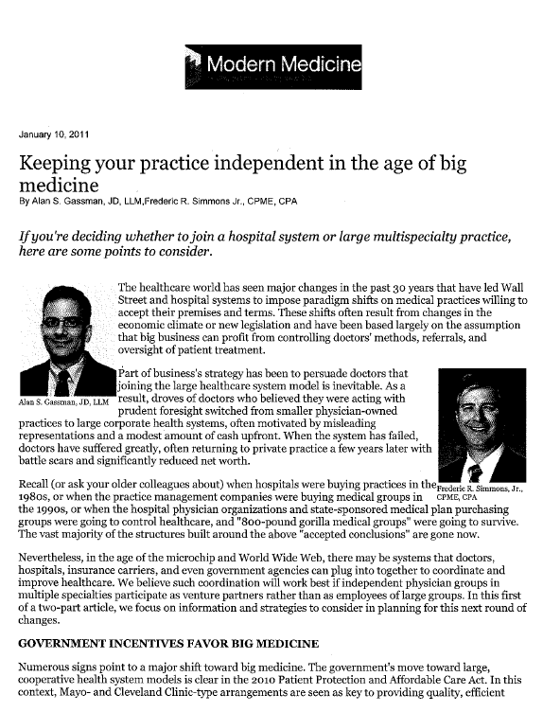
25

Slide 26
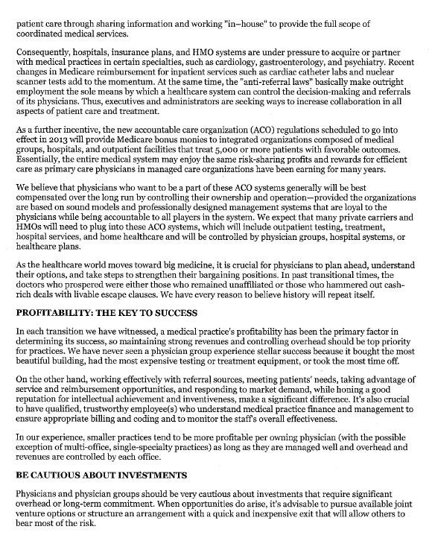
26

Slide 27
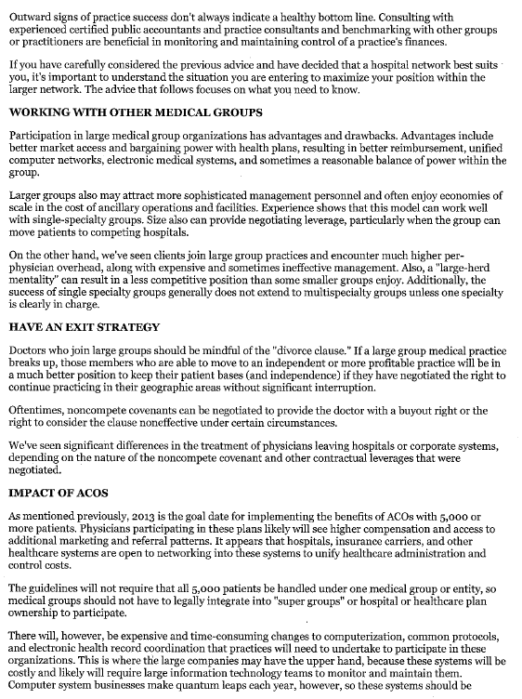
27

Slide 28
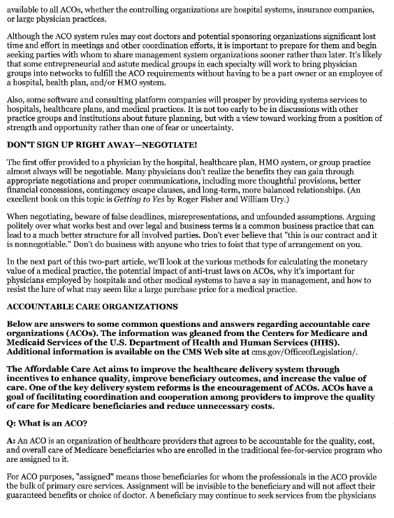
28

Slide 29
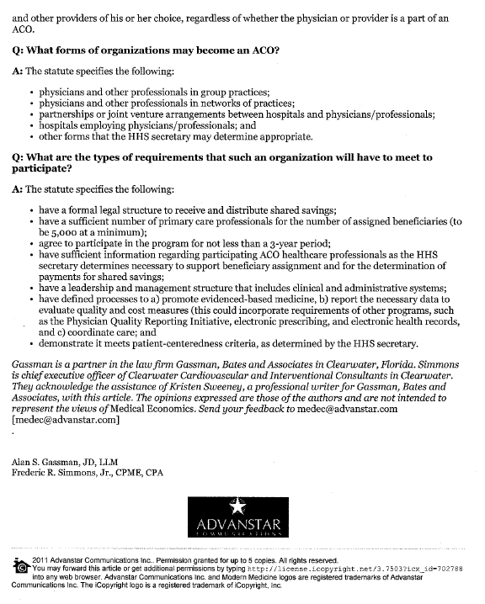
29

Slide 30
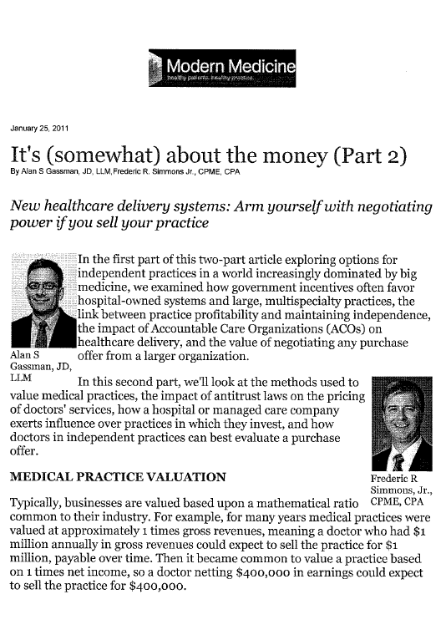
30

Slide 31
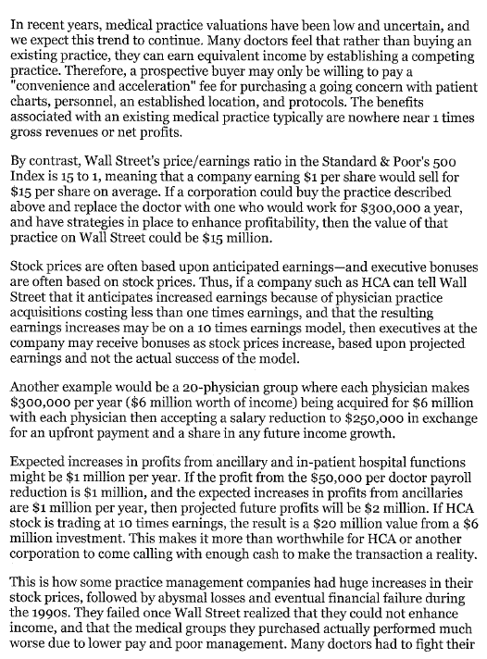
31

Slide 32
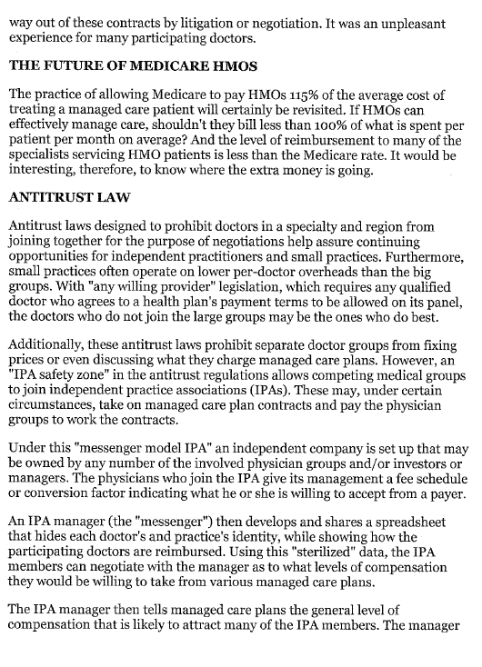
32

Slide 33
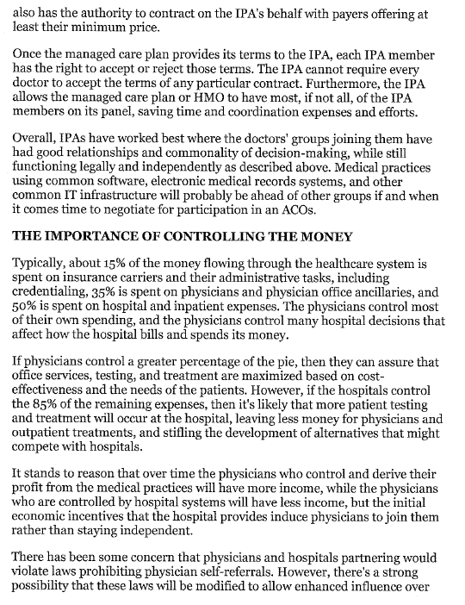
33

Slide 34
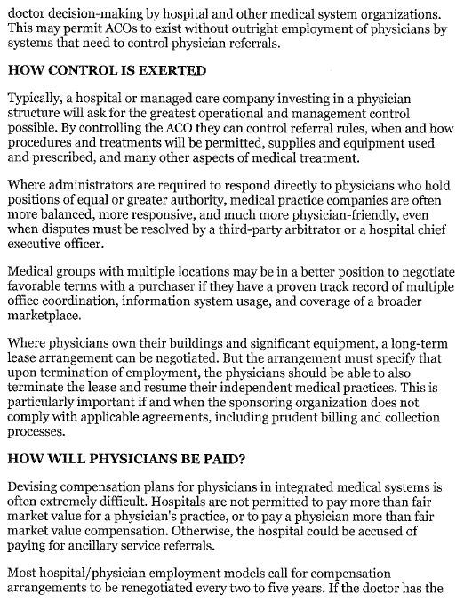
34

Slide 35
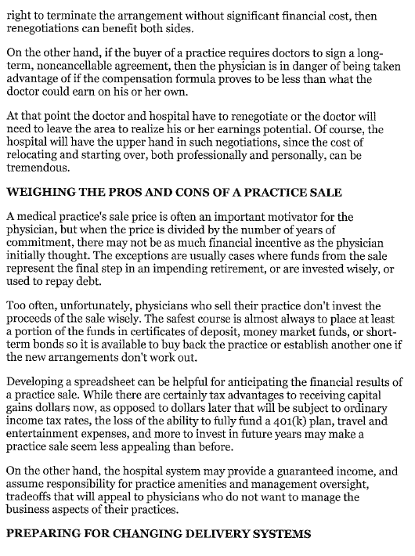
35

Slide 36
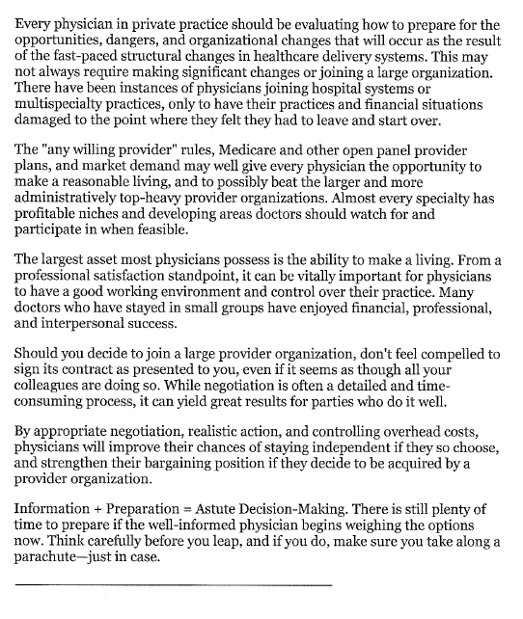
36

Slide 37
50 WAYS TO LEAVE YOUR OVERHEAD
How to Enhance Medical Practice Income and Enjoyment Using Established Methodology and Analysis
Featuring quotations by recognized business strategist Dan Sullivan and successful entrepreneurial physicians and advisors.
By: Alan S. Gassman, J.D., LL.M. and Frederic R. Simmons, CPA, CMPE
Copyright © 2013
37
Introduction
There are many ways to increase revenues and decrease expenses of a medical practice.
While many physicians and their advisors have worked diligently for years to increase the physician’s bottom line, others have simply endeavored to provide the best medical services possible, and have accepted whatever the resulting physician profit and benefits have been, without concentrating on the economics of the practice.
Time and time again, we have seen how income enhancement can go hand-in-hand with maximizing medical practice profits and minimizing expenses in a reasonable fashion. Experience has shown over and over again that the principles described in this paper are sound and should be seriously considered by any medical practice, regardless of size or nature.
This profits/expenses relationship is where we derive the term “overhead.” In a typical business, overhead is described as operating expenses that are not directly involved with generation of revenues. In a medical practice, overhead is any expense other than physician or provider salaries, benefits and taxes.
Obviously, every medical practice in Florida is under more pressure than ever to reduce expenses and increase revenues.
Patients will be better served by a practice that has financial stability and resources. Profitability is not an ugly word in medicine.
Not all physicians or physician’s office managers have the knowledge or the knack for business development and decision-making. Fortunately, there are many good sources of help in these areas, and several common denominator strategies that can be employed to help make sure that a medical practice is run in the best interests of its physicians, personnel, patients, and family. “I almost always see a direct correlation between happiness and enthusiasm and high income and achievement when I talk to physician clients about their medical practice and income.” – Alan S. Gassman, Esquire

Slide 38
50 WAYS TO LEAVE YOUR OVERHEAD
How to Enhance Medical Practice Income and Enjoyment Using Established Methodology and Analysis
Featuring quotations by recognized business strategist Dan Sullivan and successful entrepreneurial physicians and advisors.
By: Alan S. Gassman, J.D., LL.M. and Frederic R. Simmons, CPA, CMPE
Copyright © 2013
38
From a mathematical standpoint, there are several business principles that can easily be understood. These are as follows:
1. The bottom line is the difference between revenues and expenses. If revenues go up and expenses go down, then the bottom line is larger.
On the other hand, sometimes it is worthwhile to add expenses that will further enhance revenues, such as for advertising, the ability to offer new services, or capital additions that will pay for themselves.
David Gans, MSHA, FACMPE, vice president of Innovation and Research, for the MGMA, made two important observations in his April 2005 article; Overhead, How Much Is Too Much? How Much Is Too Little? These observations were based on an analysis of the MGMA cost survey: 2004 report based on 2003 data and were as follows:
a. Multispecialty groups with the lowest overhead as a percentage of revenues are the most profitable. So, medical groups with the lowest percent overhead have the most money left over to pay physician salaries and benefits, but;
When profitability for multispecialty groups is analyzed by the total dollar amounts of overhead cost per physician, profitability (salary and benefits per physician) generally increases as the dollar value of operating cost per physician increases. It is only at the highest values of operating cost per physician that the trend of increasing profitability reverses. Mr. Gans notes “that increased expenditures can actually reduce the percent overhead, as long as the revenue increases.” He further stated that "most of the multispecialty groups that reported the lowest percent overhead were also the practices that had the highest total operating cost per physician."
Cutting unnecessary expenses out of a practice while spending money on revenue enhancers makes sense. It really does take money to make money. This is where an interesting intellectualization and realization of profits from untapped opportunities can make a real difference for a medical practice. An example of this is properly chosen advertising, which brings in higher paying cases and clientele to make economies of scale and valuable resources more effective.

Slide 39
50 WAYS TO LEAVE YOUR OVERHEAD
How to Enhance Medical Practice Income and Enjoyment Using Established Methodology and Analysis
Featuring quotations by recognized business strategist Dan Sullivan and successful entrepreneurial physicians and advisors.
By: Alan S. Gassman, J.D., LL.M. and Frederic R. Simmons, CPA, CMPE
Copyright © 2013
39
2. Integrated with the above is the concept that physicians should be employed at their highest and best uses—doing what they enjoy the most and what they don’t enjoy the least.
Successful medical entrepreneurs and world-class physicians have learned from trial and error that it is possible to delegate responsibilities and tasks to better position physicians to do what they do best, and what the health care system pays the best for.
Time and time again, the authors have seen medical practices successfully implement each of the techniques set forth below. This does not have to be rocket science. There are many good general business success books that physicians and their managers may want to review, such as Good to Great, Thriving on Chaos, and Art of the Deal.
3. While many strategies and planning ideas discussed in this article interact with one another and have implications that need to be reviewed from several perspectives, we have divided the planning opportunities and considerations into the following categories:
a. Finding out what pays the most and streamlining your services.
b. Enhancement of billing and collection systems.
c. Delegation of services and efficiency of your time.
d. Marketing to raise volume in areas that work best for the practice.
e. Controlling expenses.
This article should be useful to all medical practices, particularly medical practices that have never looked at expending time and energy on profitability and entrepreneurial efforts. Practices new to strategic business planning should be able to obtain quick results using many of the ideas set forth herein.
While not every idea will work, and many ideas may require careful investigation, we urge all readers to implement the “no brainer low-cost” ideas that you will find here without delay, while also looking at the other ideas and opportunities with independent, ethical, and well-qualified advisors.

Slide 40
50 WAYS TO LEAVE YOUR OVERHEAD
How to Enhance Medical Practice Income and Enjoyment Using Established Methodology and Analysis
Featuring quotations by recognized business strategist Dan Sullivan and successful entrepreneurial physicians and advisors.
By: Alan S. Gassman, J.D., LL.M. and Frederic R. Simmons, CPA, CMPE
Copyright © 2013
40
Don’t Forget the 80/20 Rule:
In any business 80% of the best customers, clients, or patients come from 20% of the referral sources, 80% of the revenue comes from 20% of the customers, clients, or patients, 80% of the problems come from 20% of the customer, clients, or patients, and an unlimited number of other correlations apply. For example, 20% of the work on a particular project will often yield 80% of the result. Think about that if you tend to completely finish one thing before approaching a second thing – perhaps it is better to be 20% done with four different projects that someone else can take over, as opposed to working hard to complete one when you have already received 80% of the benefit from your efforts. Obviously, anything started that merits completion should be properly completed, but is that necessarily your job as a doctor, business owner, or bottle washer?
5. At the same time, every physician should be looking for opportunities to enhance his or her job satisfaction and work productivity. Often these changes will run parallel with the strategies that we describe here. For example, a doctor may be tired of handling an office practice and a hospital practice at the same time, and may conclude that focusing on one of the practices and reducing or eliminating the other practice would be much more profitable and lead to higher job satisfaction.
Other doctors may conclude that they should be making more use of nurse practitioners or physician assistants to handle certain types of functions or cases that they have not been delegating or attempting to attract in the past.
Some physicians may also conclude that they should be joining forces with other groups or venture partners, whether formally or informally, in order to best achieve their goals.
6. Integrating the business-side of a physician’s practice, rather than solely focusing on patient care will make a difference. This is an overall theme in the enhancement of any practice.

Slide 41
50 WAYS TO LEAVE YOUR OVERHEAD
How to Enhance Medical Practice Income and Enjoyment Using Established Methodology and Analysis
Featuring quotations by recognized business strategist Dan Sullivan and successful entrepreneurial physicians and advisors.
By: Alan S. Gassman, J.D., LL.M. and Frederic R. Simmons, CPA, CMPE
Copyright © 2013
41
“The real breakthrough is to see yourself as an entrepreneur… when you come out of your specialized training and [find yourself] in the real world of marketing and selling and running your business, you have to switch over to an entrepreneurial model. [This model] will allow you to 1) do the things that you really love doing, 2) to become increasingly productive and profitable and thirdly, that you’re going to have a lifestyle that’s actually your biggest reward for your biggest success.” – Dan Sullivan, Strategic Coach
If you find yourself struggling with the concept that a physician can both care for patients and be an entrepreneur or businessperson, remember this advice from Dan Sullivan of the Strategic Coach program: “The word entrepreneur comes from a French economist who said that an entrepreneur is simply someone who takes resources from a lower level of productivity to a higher one. One of the misconceptions about entrepreneurs is really that it’s all about the money, and yet my experience has been that entrepreneurs spend less time talking about money than almost anyone I know. The main draw is… really freedom. There are four freedoms that to a certain extent people can never get enough of. One of them is Freedom of time, that more and more you have control over your time so that you’re constructing your [time] how you would like [it] to be structured. The second one is money, there’s not a limit on how much money you can make and the way you make money is increasingly enjoyable and satisfying to you. Third is the freedom of relationship that you can deal with who you want to deal with out in the marketplace and within your own organization. Finally there is freedom of purpose; you have a particular gift, a particular focus in the marketplace about people that you would really like to help.” The rules set out here will help you take that next step to better management of your business, and greater freedom for all of those other things that come along with it.
The Rules
Goal: Increase Revenues
Rule #1: Do More of What Pays More and Less of What Pays Less
Many physicians are unaware of how their overall practice functions and how certain services provided to patients reimburse significantly more often or better than others. A well-organized and profitable medical practice will typically have found the three to five different patient services and/or procedures that provide the best professional and economic success, and then will have taken continual steps to make sure that the practice is efficiently and effectively maximizing its patient volume for these services.

Slide 42
50 WAYS TO LEAVE YOUR OVERHEAD
How to Enhance Medical Practice Income and Enjoyment Using Established Methodology and Analysis
Featuring quotations by recognized business strategist Dan Sullivan and successful entrepreneurial physicians and advisors.
By: Alan S. Gassman, J.D., LL.M. and Frederic R. Simmons, CPA, CMPE
Copyright © 2013
42
Most physicians can receive this information simply by asking their office manager or billing system consultants for a printout showing revenues derived for each category of services provided by the practice.
Most physicians also know intuitively or without hesitation what they enjoy doing the most, and what means the most for patients and referral sources.
Many successful practices over the years have identified a specific subspecialty or publicly perceived subspecialty and have named their practice or a division thereof after the subspecialty.
“The Center for Arthroscopic Shoulder Surgery,” the “ABC Sleep Clinic,” or the “Center for Facial Surgery” are examples of names and practice philosophies that can help to bring together both community reputation and identity. Branding a practice by name can also bring about greater expertise in that subspecialty; leading to higher patient volume, the ability to offer a wider range of services and procedures within that subspecialty, and an increase in ancillary functions that will serve patients, the community, and the physician well.
Rule #2: Limit the Services That Pay the Least
While looking at which of your practice functions provide the highest revenue, also find out what services provide the lowest.
There may be categories of services or responsibilities that your medical practice should simply no longer make available, except upon special occasion.
Are there certain procedures or categories of patients that you are not well adapted for that could be referred to another practice that might appreciate the patients you send, thus enhancing your relationships?
By integrating both of these rules, you will be able to enhance the value of your services because you are focusing on those that you do well, that you enjoy doing, and have the highest demand.

Slide 43
50 WAYS TO LEAVE YOUR OVERHEAD
How to Enhance Medical Practice Income and Enjoyment Using Established Methodology and Analysis
Featuring quotations by recognized business strategist Dan Sullivan and successful entrepreneurial physicians and advisors.
By: Alan S. Gassman, J.D., LL.M. and Frederic R. Simmons, CPA, CMPE
Copyright © 2013
43
Rule #3: Expand Services by Hiring Help
Can you hire a subspecialist to come into your practice one-half day a week to perform certain patient services that you have been sending out in the past? Can you hire that subspecialist to be a part of your practice? This could be a radiologist, a cardiologist, an optometrist, or even an audiologist.
By hiring others you will be able to divide up the workload so that you and the rest of your team can focus on what it is you each excel at and enjoy the most. In this way you are working more efficiently, not more often. Again, you will be able to add to the value of your own services and patient care if you are not doing and administrative paperwork, for instance.
“We have six doctors that we’ve leveraged because we have about 30 providers of care that see patients that allow our doctors more freedom. We have, for instance, [employees] that will come into the rooms for us and do all of our electronic medical record input so that our doctors spend [their] time face to face with the patient. While I am still talking to the patient, before we walk out the door, the prescription for their medications is [being brought] to them. We’ve created a system where you have a lot of patients and a lot of freedom. Our doctors… have as much vacation time as they want.” – Pat Do, Orthopedic Surgeon, Kansas
If you are concerned about the expense of adding additional services, other expense reduction opportunities include simply not allowing employees to work overtime. The overtime rules make it clear that any employee who works more than 40 hours per week must be paid at time and a half unless they are legitimate management personnel who make hire and fire decisions in the practice or licensed professionals who are otherwise not covered under the overtime law requirements. Employees can be asked to notify the practice before they work overtime, and to leave early on one day if they have stayed late to get work done. Jobs are getting harder and harder to find, and most good employees understand this and are willing to cooperate to help medical practices keep their costs down.
Alternatively, should you bring on a full-time or part-time nurse practitioner or physician who would like to handle a category of work at a different compensation structure than what applies in your practice for the other higher-paying services?

Slide 44
50 WAYS TO LEAVE YOUR OVERHEAD
How to Enhance Medical Practice Income and Enjoyment Using Established Methodology and Analysis
Featuring quotations by recognized business strategist Dan Sullivan and successful entrepreneurial physicians and advisors.
By: Alan S. Gassman, J.D., LL.M. and Frederic R. Simmons, CPA, CMPE
Copyright © 2013
44
One question for your billing consultant is what services other similarly situated practices are providing that you may not be.
For example, if you are an ENT group is it time to begin providing allergy services for a certain category of patients?
If you are an allergist is it time to hire an ENT so that you can offer ENT services to your patients that would otherwise be referred out?
Rule #4: What Equipment or Ancillaries Enhance Patient Services while Increasing the Bottom Line?
Many practices now have CT scanners and MRI machines that are much less expensive and easier to use than in past decades.
Just because it did not make sense to acquire that equipment and change your practice ten years ago, it does not mean that now might not be the right time.
Oftentimes equipment and software can be purchased on a used or demonstration model basis at much less than what you might have thought you would have had to pay for the same equipment a number of years ago.
Reputable contractors are often available to provide equipment on a one day a week or similar basis.
Urologists are now providing radiation therapy services, as are other specialties.
What trends are occurring in your specialty that will be attractive investments for you?
Of course, you do not want to get carried away or talked into purchasing something that will not pay for itself several times over if things go well.

Slide 45
50 WAYS TO LEAVE YOUR OVERHEAD
How to Enhance Medical Practice Income and Enjoyment Using Established Methodology and Analysis
Featuring quotations by recognized business strategist Dan Sullivan and successful entrepreneurial physicians and advisors.
By: Alan S. Gassman, J.D., LL.M. and Frederic R. Simmons, CPA, CMPE
Copyright © 2013
45
Many physicians added cosmetic laser and similar equipment to their practices before the economic crisis began in 2008, and have been saddled with lease payments or finance agreements that now have a detrimental effect upon their practice.
Rule #5: Patient and Payor Selection
Patient scheduling selectivity can also be an important part of maximizing the use of profitable opportunities.
Does your reception desk know that you always keep slots open one or two days a week for patients who are in need of certain services or immediate help in areas of medical business that you want to attract? Are you offering evening or Saturday hours to certain patients?
Rule #6: Increasing Volume while Helping Patients
How many primary care doctors make sure that their office calls a patient when it is time for an annual checkup, or for follow-up on periodic testing within the guidelines recommended by Medicare or other appropriate agencies?
Waiting for patients to call of their own volition for appropriately supervised treatment and continuity of care can be a big mistake, both from a malpractice and financial result standpoint.
Take a lesson from your dentist, who doubtlessly reminds you and all of his or her other patients of their annual cleanings and x-ray sessions.
Let your patients know that if they are sick or experience any type of situation that they are not sure of, then they should call or come into the office for a visit.
“In our office we’ve set up systems where we’re like American Airlines. We know exactly how many folks might not show up and we’ll schedule sufficiently. We run two operating rooms and we know what the bottleneck is so that we can do many more cases in a much shorter period of time. [I got] these ideas from somebody completely outside medicine – manufacturing.” – Pat Do

Slide 46
50 WAYS TO LEAVE YOUR OVERHEAD
How to Enhance Medical Practice Income and Enjoyment Using Established Methodology and Analysis
Featuring quotations by recognized business strategist Dan Sullivan and successful entrepreneurial physicians and advisors.
By: Alan S. Gassman, J.D., LL.M. and Frederic R. Simmons, CPA, CMPE
Copyright © 2013
46
Rule #7: Keep the Good Patients Coming Back
“Never be careless with anyone’s support.” Dan Sullivan
Patients are not in a position to know whether you are the best doctor or the worst doctor in the community, but they do know if they believe whether they are being treated properly and whether your office is run in a friendly, professional, and organized manner. “I would call them clients, not patients, because they choose whether to come to you or not.” - Alan S. Gassman, Esquire
Thus you want to make sure the patient experience is the best possible to keep them returning.
This is not the case when a patient walks in and your receptionist is too busy eating lunch at the reception desk to acknowledge their presence. It is also not the case when a patient is told that their appointment will be at 2:30, and no one even lets him or her know that you are running late until 3:45.
Further, do you have your lowest-paid and least-talented person answering the phone and politely checking in patients and asking for co-pays? Does a visit to your office reflect a poorly run, inefficient business for patients who are entrusting you with their medical treatment and a large portion of their expendable monies?
All of the marketing in the world cannot overcome a poor front desk operation. Further, if the person answering the phone cannot take an intelligent and thorough message for patients who are calling about medical phenomena, then the practice is being put at unnecessary risk. The difference between a good front desk person and a mediocre one is not significant enough for you to cut corners! Patients need to feel that they are going to a medical office, not a pawn shop.

Slide 47
50 WAYS TO LEAVE YOUR OVERHEAD
How to Enhance Medical Practice Income and Enjoyment Using Established Methodology and Analysis
Featuring quotations by recognized business strategist Dan Sullivan and successful entrepreneurial physicians and advisors.
By: Alan S. Gassman, J.D., LL.M. and Frederic R. Simmons, CPA, CMPE
Copyright © 2013
47
The broader point to understand and apply to your business is that your patients are your clients. They choose to come to you, instead of some other physician. You are also largely in control of the clientele that you can attract by providing exemplary customer relations. It is important to adjust your way of thinking from solely providing medical care to always providing good customer service. This is not only true of the person who works at the front desk (although they are the first impression of your business), but of all other nurses, physician assistants, administrators, and employees at your practice, including yourself.
“I think the single biggest obstacle that [we, as physicians] have is that [we] come from a very technical background. The biggest realization sometimes is that you’re a customer service provider, and once you realize that the more customer service you provide, and the better your technical abilities are utilized. Doctors receive almost no education on running a business or providing customer service. What I’ve learned is that focusing on the customers who are willing to spend more on services means that you are focusing on that 20% of clients that provide 80% of your income. [This means] you work less and you see more of the patients you love, and you are utilizing your abilities more efficiently [rather than working more hours]. Now I am working less but the size of my practice has doubled.” – Brent Caulk, Facial Plastic Surgeon, Iowa
Rule #8: Addressing Managed Care Plan Payors
While many physicians have reported that they will accept any managed care plan reimbursement rate because at least they make something on the added volume, the more successful practices have been able to establish sufficient patient volume from Medicare, reasonable paying payors, or sometimes even Medicaid in order to not be dependent upon the lowest paying payors for any patient volume whatsoever.
While many doctors have historically been very reluctant to advertise, or otherwise take aggressive steps to bring patients into their office, it is a simple truth that it can make a great deal of economic sense to spend some money or to expend personal time to attract patients who are on the managed care plans that pay you reasonably.
Would you rather be spending four hours a week working on nominally profitable patient cases where you may be sued for malpractice, or giving talks in the community or to colleagues about the area of specialization that you enjoy the most, and which your practice is paid reasonably for?

Slide 48
50 WAYS TO LEAVE YOUR OVERHEAD
How to Enhance Medical Practice Income and Enjoyment Using Established Methodology and Analysis
Featuring quotations by recognized business strategist Dan Sullivan and successful entrepreneurial physicians and advisors.
By: Alan S. Gassman, J.D., LL.M. and Frederic R. Simmons, CPA, CMPE
Copyright © 2013
48
You can take notice of what your colleagues in the community have been doing and keep one rule of thumb in mind: When a physician practice is advertising over a long period of time using the same technique it is not because they are desperate—it is because it is working. Just as Burger King used to be able to locate its restaurants by simply placing them across the street from McDonald’s, you can begin using the same techniques that your colleague/competitors use.
One financial advisor that we have much respect for has told clients to go to California to see what they are doing there for practice marketing, and to start doing it here because it will probably work. You can call your colleagues from residency and training in different parts of the country to see what their group is doing from a marketing and patient attraction standpoint.
Rule #9: If You Want to Catch Fish, Go Where the Fish Are
Just as well-equipped fishing captains now have sonar and sometimes public and sometimes confidential fishing hole and fish population information, you can focus in on where the patients are coming from, or where you need to go in order to service them successfully.
This may involve setting up a one-day-a-week office near important referral sources that are five to eight miles away from your office, leasing space one-half a day a week from a primary care group who refers you a significant number of patients so that you can have your initial consultation with their patients at their office, making arrangements with nursing homes to provide that you will go to their facility to see their patients in your area of specialty on a periodic basis, or advertising about or supporting public causes associated with your area of specialty, such as high schools sports programs if you are involved with sports rehabilitative medicine, or YMCA diabetic programs if you are an endocrinologist.
Have a good CPA compare your financial statements with financial statements of other doctors in your specialty to let you know how your ratios may be different.
Commonly, clients who have not worked hard on business development are told that their colleagues spend more on advertising and have greater profitability because of the volume of services provided.

Slide 49
50 WAYS TO LEAVE YOUR OVERHEAD
How to Enhance Medical Practice Income and Enjoyment Using Established Methodology and Analysis
Featuring quotations by recognized business strategist Dan Sullivan and successful entrepreneurial physicians and advisors.
By: Alan S. Gassman, J.D., LL.M. and Frederic R. Simmons, CPA, CMPE
Copyright © 2013
49
Other times, physicians learn that they have higher overhead in categories that may be controllable. For example, if you are paying above-market rent and your lease is coming up for renewal, you may be able to negotiate a lower rate; or you may be able to reduce what you pay for malpractice insurance, equipment maintenance, or other expenses.
It is very easy to be complacent in the expense area, and to assume that what your practice is spending on various items is the lowest possible cost, but this is rarely the case. The bottom line is that you should periodically seek competitive bids on all of your expense items.
Rule #10: Spreadsheet Expenses and Revenues
Many practices spreadsheet their revenues and expenses in a manner similar to that shown on Exhibit A. A monthly spreadsheet may be linked to Quickbooks or other software packages that the practice already has in place, and will help identify any abnormalities that should be brought to the attention of the practice manager or owners. If and when a particular category of expenses goes up or has significant variances, a quick look at the situation and review of how to reduce the overall expense will often be useful.
The same analysis applies if and when the practice can have its CPA or other financial advisers compare its financial statements to similarly situated medical practices. Examples of expenses that might be reduced include insurances. Insurance agents are normally paid a percentage of the premium for the policies they sell or renew, and therefore may have limited motivation to notify the practice of opportunities to reduce premiums by changing to more competitive carriers or to higher deductibles.
Malpractice insurance can also be reviewed from both an expense and coverage standpoint. There are many more malpractice insurance carriers in Florida, and the competition for doctors in almost every category of practice and risk class is significantly higher than it was in the past. In addition, it may be possible to add corporate liability coverage to an already existing individual physician package in order to increase the amounts that would otherwise be available to satisfy a plan, and to help assure the practice meets doctors’ needs and does not purchase the tail that the practice will still be protected.

Slide 50
50 WAYS TO LEAVE YOUR OVERHEAD
How to Enhance Medical Practice Income and Enjoyment Using Established Methodology and Analysis
Featuring quotations by recognized business strategist Dan Sullivan and successful entrepreneurial physicians and advisors.
By: Alan S. Gassman, J.D., LL.M. and Frederic R. Simmons, CPA, CMPE
Copyright © 2013
50
Rule #11: Ask (for Discounts) and You Shall Receive
You do need to use dependable and reputable suppliers, but you may be surprised at how quickly they will give you a discount if you simply let them know that you have been told that their competitors have lower prices for the same or similar services.
Many practices offer their patients physical therapy, mental counseling, massage therapy, radiology services, weight-loss counseling, and metabolic (aging) services; either by having members of the practice learn to provide these items, or hiring someone who is willing to do this on a part-time basis while the practice evaluates how this fits in with goals, opportunities, and operations.
Rule #12: Use a Good Billing and Practice Protocol Consultant
Most practices will profit from having a no-nonsense medical billing consultant spend a few hours reviewing their patient files to gauge the following:
a. Where the charts for properly supporting coding and bills sent are being kept;
b. Whether coding and bills sent maximize the appropriate compensation that the practice should receive for the services rendered;
c. Whether the practice is making sure that it is paid under the bill by collecting the co-pay and following up with any carrier questions or tardiness issues; and
Whether any of the personnel of the practice are in a position to steal by telling the billing computer that a patient account was written off or collected, and whether monies have been spent by or gone into the hands of a dishonest employee.
Practices that give one person the ability to write off an account on the billing computer and also to receive checks in the mail are asking for theft to occur. When theft is finally detected, the typical amount stolen exceeds $75,000, and is usually not recoverable.
A billing consultant can also help to assure that the practice is aware of other services or opportunities that other clients of the billing consultant may be utilizing.

Slide 51
50 WAYS TO LEAVE YOUR OVERHEAD
How to Enhance Medical Practice Income and Enjoyment Using Established Methodology and Analysis
Featuring quotations by recognized business strategist Dan Sullivan and successful entrepreneurial physicians and advisors.
By: Alan S. Gassman, J.D., LL.M. and Frederic R. Simmons, CPA, CMPE
Copyright © 2013
51
The authors have seen practices significantly increase their income while reducing risk and eliminating certain inadvertent billing mistakes that the practice may have been making through the use of a billing consultant.
A good billing consultant will also often be able to spot employees who are not doing their jobs properly, and management system and protocol situations that can be materially improved with little or no effort.
Many practices wait to reap the benefits of a good medical billing consultant until Medicare or an insurance plan has audited files and demanded significant repayments, and the practice has lost years of opportunity to actually be billing and collecting more than it had been.
Rule #13: Focus on Your Team
“Treat your employees like an investment, not like a cost.” Dan Sullivan
“We have to provide good customer service to those people who take care of our patients. By finding out the real strengths of the people who take care of us, who run our offices, makes us more fulfilled in the work we’re doing and makes it a lot easier to provide good service to [our patients].” - Kirsten Hurder-Karchmer, Director Center for Reproductive Acupuncture, Texas
Focusing on your team members and creating a positive environment for them will reflect on the work they do, the satisfaction of your patients, the efficiency of your office, and ultimately improve your practice.
“What I’ve noticed is that if I stay on the outside and have a perspective toward being a motivator for my team, and craft the team and new strategies for motivating that team I don’t have to do as much surgery as I used to. I can focus on the 20% of patients that make me 80% of the money.” – Brent Caulk

Slide 52
50 WAYS TO LEAVE YOUR OVERHEAD
How to Enhance Medical Practice Income and Enjoyment Using Established Methodology and Analysis
Featuring quotations by recognized business strategist Dan Sullivan and successful entrepreneurial physicians and advisors.
By: Alan S. Gassman, J.D., LL.M. and Frederic R. Simmons, CPA, CMPE
Copyright © 2013
52
“What I value a lot is when we create such a good environment our employees are doing what they do best [and] everybody’s happy. My relationship [with my employees] is so good that I get compliments all of the time about my staff from my patients and they do almost all the work by the time I walk into the exam room.” - Pat Do
Dan Sullivan often asks the question as to whether you would rehire a present employee if you were interviewing to fill their position today. If the answer is no, then you need to think about what this employee is costing you in terms of lost productivity, loyalty, attitude, or whatever the reason is that you would not hire them now.
Unemployment compensation rates relatively low for medical staff employees, so letting go of an employee who is not the optimum match for the practice will often result in that person finding a position that is more to their liking and job performance that is more acceptable to the next person who hires them.
Some practices give a financial reward to office managers when they terminate employees in order to counter-balance the normal human tendency to not want to terminate someone whose performance is not quite up to standard.
It is vitally important that all new employees sign a 90 day conditional job acknowledgment, so that the practice will not have responsibility on its unemployment compensation rating for an employee who was terminated during the first 90 days of unemployment. It is well worth the time and effort to make sure that an employee knows what is expected of him or her and that an employee is a good match for the practice before the 90th day of employment comes.
It is much less expensive and more profitable in the long run to give generous severance packages to those team members whose positions may be eliminated or filled by someone who is a better match for the practice.
Of course, practices have to be careful not to discriminate with respect to race, religion, sex, nationality, or other protected criteria. Nevertheless, Florida is a “right to work state” and unless there is something to the contrary in writing, any employer can terminate any employee without notice of cause.

Slide 53
50 WAYS TO LEAVE YOUR OVERHEAD
How to Enhance Medical Practice Income and Enjoyment Using Established Methodology and Analysis
Featuring quotations by recognized business strategist Dan Sullivan and successful entrepreneurial physicians and advisors.
By: Alan S. Gassman, J.D., LL.M. and Frederic R. Simmons, CPA, CMPE
Copyright © 2013
53
Many practices are well advised to have an independent insurance agency review present coverages every two or three years to help spot gaps in coverage and premium savings opportunities.
"Invest in your staff - the receptionists, nurses aides and nurses, billing clerks and others. These are the frontline persons who engage with your patients. If they are upbeat and enthusiastic patients feel it and respond well. They also recommend you to their friends and relatives. Programs that help your staff combat stress and gain perspective are a very sound investment." – Srikumar S. Rao, Author of “Happiness at Work.”
Rule #14: Assess Your Office
Be assertive and ask questions constantly. Put yourself in the shoes of the customers you are trying to serve in a quality healthcare environment.
Walk into your own waiting room and pretend that you are a patient. Does this look like where you would want to be coming for medical services? Do the personnel appear to be professional and busy? Are patients able to hear about each other’s personal matters from the waiting room and/or checkout lane?
Does your practice have resources that could be used by others to help you reduce overhead? One client set up an evening walk-in clinic owned by his wife to simply use the existing space, signage, and utilities from his practice. The walk-in clinic is now more profitable than the actual daytime medical practice, and the community is very well served by having the evening availability of a medical doctor at that location. The urgent care center also results in occasional referrals to the doctor.
Are your patients experiencing the type of visit that will cause them to recommend your offices to their friends and your colleagues?

Slide 54
50 WAYS TO LEAVE YOUR OVERHEAD
How to Enhance Medical Practice Income and Enjoyment Using Established Methodology and Analysis
Featuring quotations by recognized business strategist Dan Sullivan and successful entrepreneurial physicians and advisors.
By: Alan S. Gassman, J.D., LL.M. and Frederic R. Simmons, CPA, CMPE
Copyright © 2013
54
Rule #15: Use Benchmarking to Identify Changes You Can Make to Your Own Practice
How can a medical practice tell if its overhead is too high, if it is providing the right mix of services or if it has too many staff members on its employee roster? One effective tool is to benchmark your practice against others. Modern business benchmarking was developed by Xerox Corporation, which defines benchmarking as “the continuous process of measuring products, services and practices against the toughest competitors which are those companies recognized as industry leaders (best in class)." Benchmarking can be as simple as comparing your practice results to those of a friendly colleague who is willing to share his or her results. A more formal and effective way to benchmark is to compare your practice against industry benchmarks.
For medical practices, benchmarking information can be gleaned from the MGMA, AMA, Medical Economics, or Specialty Societies. Medical practices can benchmark revenues (amounts and service types), expenses (operating cost), staffing levels, physician productivity, and a host of other measures. Once a doctor determines how his or her practice compares to his or her peers, the practice should make appropriate changes and then measure results after making those changes.
Rule #16: Avoid Negativity by Learning How to Cultivate Positivity and Fostering a Positive Professional and Business Atmosphere
“Always reward creators. Never reward complainers.” Dan Sullivan
There is a direct correlation between having a positive attitude and succeeding financially and professionally. This has been made clear by the experience of hundreds of physicians and physician practices that we have worked with in the past, and with other businesses and professionals as well.
It is possible to look at any situation from a negative standpoint, which is interesting since we live in a country that has more opportunities, wealth, technology, and better personal living standards than any other country in the history of mankind, but nevertheless countless professionals find ways to be unhappy and downright miserable as a matter of habit and learned attitude. The authors have found that successful medical practices and practitioners find the positive side of circumstances and look for opportunities and challenges as opposed to using condemnation and having “pity parties” all the time. The Authors find that the doctors who have the best medical practices are constantly striving to improve their practices and business methodology. They are enthusiastic about making things better and correcting and eliminating obstacles to progress.

Slide 55
50 WAYS TO LEAVE YOUR OVERHEAD
How to Enhance Medical Practice Income and Enjoyment Using Established Methodology and Analysis
Featuring quotations by recognized business strategist Dan Sullivan and successful entrepreneurial physicians and advisors.
By: Alan S. Gassman, J.D., LL.M. and Frederic R. Simmons, CPA, CMPE
Copyright © 2013
55
Those who positively look to the big picture and have enthusiasm towards improvement do better. They are the 20% of physicians who make 80% of the money. If you do not look at your work positively, it is not going to improve your revenues.
There are a great many good books and courses that can be used to change business, personal, and professional cultures to enhance performance and enjoyment of circumstances. These types of resources can have a big impact on personal, professional and financial performance for physicians and those who they work with.
Some books the Authors recommend include Happiness at Work by Dr. Srikumar Rao, The Gratitude Principle and The 21 Day Positive Focus (audio guides and workbooks) by Dan Sullivan, and Think and Grow Rich by Napoleon Hill.
Just try having a typical complaining employee or colleague be required to state three positive items about a situation before they can complain about it, and try thinking about three positive things and good opportunities before the beginning and end of each day. This can have a tremendous impact upon professional enjoyment, family life, and profitability. “You are what you think.” For major Rao, Srikumar. reprogramming we recommend the book Are You Ready to Succeed by Dr. Srikumar Rao and his Youtube Videos from TED.com and GoogleTalks.
Many successful doctors participate in workshops and attend programs that can include the local Dale Carnegie courses, Strategic Coach workshop programs, Franklin-Covey workshops, and other one-time or lifetime programs, and derive significant benefits from these.
“If your career is not your favorite activity then what does it take to make that happen?” - Alan S. Gassman, Esquire

Slide 56
50 WAYS TO LEAVE YOUR OVERHEAD
How to Enhance Medical Practice Income and Enjoyment Using Established Methodology and Analysis
Featuring quotations by recognized business strategist Dan Sullivan and successful entrepreneurial physicians and advisors.
By: Alan S. Gassman, J.D., LL.M. and Frederic R. Simmons, CPA, CMPE
Copyright © 2013
56
Rule #17: Think of Possibilities
“If opportunity doesn’t knock, build a door” Milton Berle
The following list of possible ways to raise revenues, reduce expenses, and change business models are perhaps only the tip of an iceberg of possibilities that might be considered by physicians and medical practices that wish to accelerate their progress or reduce expenses using proven strategies that have worked for others.
1. Raise Revenues:
(a) See more of the patients that pay more.
(b) Do more of the services that pay more.
(c) Provide new services that pay well.
(d) Eliminate patients and payors who pay less.
(e) Take on risk contract patients by joining an experienced IPA and/or hiring a consultant who can help make this happen with stop
loss insurance to limit risk.
(f) Medicare patients the opportunity to go with the HMO.
(g) Bring in other medical practitioners to make use of your facilities on a leased basis.
(h) Open a weight loss division.
(i) Extend hours and find a doctor to work evenings and weekends.
(j) Get a happy receptionist who is director of getting patients in, not a gate keeper.
(k) Go lighter on co-pays if they scare patients away.
(l) Have staff call patients for annual check-ups instead of sitting around on slow days doing nothing.
(m) Dispense pharmaceuticals.
(n) Have a lab in your office.

Slide 57
50 WAYS TO LEAVE YOUR OVERHEAD
How to Enhance Medical Practice Income and Enjoyment Using Established Methodology and Analysis
Featuring quotations by recognized business strategist Dan Sullivan and successful entrepreneurial physicians and advisors.
By: Alan S. Gassman, J.D., LL.M. and Frederic R. Simmons, CPA, CMPE
Copyright © 2013
57
(o) Offer concierge services.
(p) Consider expert witness and quality utilization work.
(q) Consider accident victim work and accepting Letters of Protection.
2. Be Efficient and Effective:
(a) Avoid delays within the office:
  i. Getting patients in.
  ii. Getting patients through – reduce wait times and apologize.
  iii. Billing patients.
  iv. Getting paid by carriers and patients.
(b) Have systems in place for efficiency and effectiveness. Always be improving them.
(c) Use nurse practitioners and other practice extenders efficiently.
(d) Hire a hospitalist or be a hospitalist.
(e) Use a hospitalist nurse practitioner or other extender.
(f) Reduce overhead by moving to a more efficient office or sub-leasing to others who can help make your office more efficient.
(g) Hire a specialist half-a-day a week to provide profitable services under your practice.
(h) Drastically improve your front desk to avoid loss of valuable referrals and to make your time efficient by proper scheduling.
(i) Lease a second office to draw referrals from physicians in that area.
(j) Eliminate an office that is not making money.
(k) Understand the new pain clinic drug rules and become an efficient pain drug expert.
(l) Have your coding reviewed by an expert to maximize revenues and decrease risk.
(m) Have your managed care plans reviewed by an expert to determine whether your reimbursement can be increased.
(n) Consider joining an IPA to see what kind of contractual terms they can give you.
(o) Purchase equipment that will be profitable, or consider leasing it one day a week for testing purposes.

Slide 58
50 WAYS TO LEAVE YOUR OVERHEAD
How to Enhance Medical Practice Income and Enjoyment Using Established Methodology and Analysis
Featuring quotations by recognized business strategist Dan Sullivan and successful entrepreneurial physicians and advisors.
By: Alan S. Gassman, J.D., LL.M. and Frederic R. Simmons, CPA, CMPE
Copyright © 2013
58
(p) Sell equipment that is not profitable.
(q) Run your practice like a business and run your business like a practice.
3. Different Ideas for Different Specialties
(a) Bring in a cardiologist one day a week, with testing equipment.
(b) Bring in radiation oncology associated with your specialty.
(c) Bring in a mohs surgeon one day a week if you are a dermatologist.
(d) Run away from cosmetics and medispas unless you are a dermatologist or plastic surgeon from what I have seen!
(e) Urologists and lithotripsy, urologist and radiation oncology.
(f) Bring in a radiologist and a CT scanner, etc. and pay competitive rates and bill all you can.
(g) ENTs are now doing full allergy services. Allergists need to hire ENTs?
(h) Sleep centers for pulmonologists and who else?
(i) Ophthamologists and Lasik.
(j) Oral surgeons working for dentists.
(k) Open a pain clinic or invest in one.
(l) Anesthesia groups to do epidurals in ASCs?
(m) Learn to do pain pumps.
(n) Gastric bypass work.
4. When All Else Fails:
(a) Forget the office and be a locum 1 or 2 weeks a month.
    (b) Go to work for another practice that is more profitable without a non-compete and with the right to take your files back out if and
    when you leave. Author Alan Gassman has found “some physicians are happier once they move to smaller, more entrepreneurial
    groups.”

Slide 59
50 WAYS TO LEAVE YOUR OVERHEAD
How to Enhance Medical Practice Income and Enjoyment Using Established Methodology and Analysis
Featuring quotations by recognized business strategist Dan Sullivan and successful entrepreneurial physicians and advisors.
By: Alan S. Gassman, J.D., LL.M. and Frederic R. Simmons, CPA, CMPE
Copyright © 2013
59
(c) Make your family get real jobs.
(d) Marry well.
(e) Win the lottery.
5. Do Not Be Afraid to Experiment – “Ready, Fire, Aim” – Tom Peters
Trial and error is often the only way to determine how to improve situations or to have breakthroughs instead of breakdowns. If your gut feeling is that something will work and you can test it out inexpensively go for it!
6. Read How the Best Get Better and listen to the companion CD by Dan Sullivan; read Good to Great by Jim Collins and Thriving on Chaos by Tom Peters.
7. Engage in Creative Problem Solving:
“No problem can be solved from the same level of consciousness that created it.”
-Albert Einstein
8. Hire People to Make the Above Happen!
A podcast conducted by Alan S. Gassman, Dan Sullivan and the physicians quoted in this article can be listened to by going to:
http://www.strategiccoach.com/go/medical
Einsten, Albert. http://www.brainyquote.com.

Slide 60
50 WAYS TO LEAVE YOUR OVERHEAD
How to Enhance Medical Practice Income and Enjoyment Using Established Methodology and Analysis
Featuring quotations by recognized business strategist Dan Sullivan and successful entrepreneurial physicians and advisors.
By: Alan S. Gassman, J.D., LL.M. and Frederic R. Simmons, CPA, CMPE
Copyright © 2013
60
Closing
You can analogize the structure of your practice to a system of hot air balloons. Imagine four balloons tied together, each representing a foundational element of your practice: the entrepreneur (you), the clients or patients, your team of employees and colleagues, and the systems you have in place to manage all of the previous three (the business aspect of practice). If one balloon loses air, it drags all of them down. If your practice becomes so successful you have an influx of patients, but you do not have the business model in place to handle all the new business, that balloon is held back by the others. If you can find a balance for all of the balloons in your practice, you may find yourself not only enjoying the business of medicine, but increasing your bottom line.
Begin incorporating the aforementioned techniques into your own practice and you will quickly increase the profitability, efficiency, productivity, and quality of your medical operation. Get the help you need from good professionals who have helped others. The bottom line for good patient care is to have a good bottom line in your practice and to maximize your enjoyment of the practice. Our free enterprise economic system measures economic success in dollars, so view your income as one possible dashboard indicator of the contribution that your practice makes to your patients and the community.

Slide 61
Give up and retire.
61
Notes:
The final option is to give up and retire. That might have been a good option before or 401(k)s tanked.

Slide 62

Key to success – NEGOTIATE!
62
Notes:
Whatever you do not merely take the first offer from your hospital, supergroup are merger partner. Negotiate

Slide 63
What option is best for your group?
63
Notes:
So what is the best option for your group.
Unfortunately, the court wizard could .not be here today to foretell the future

Slide 64
64
“Only the dead have seen the end of war”.
“Soliloquies in England and Later Soliloquies”, Number 256 (1922)
George Satayana
Spanish American Philosopher
Notes:
Well, we have had a little fun and we have seen that it is still “A War out There”
And since we are all still alive, I would like to close our formal remarks today with another insightful quote from that great Spanish-American philosopher.
“Only the dead have seen seen the end of war”

